Slide 1
Twelve
Sample Packet 1
September 20, 2010
Hosted By
NCASA
Sponsored By
The North Carolina Association for Scholastic Activities
Twelve: Sample Competition
Copyright © 2010. All Rights Reserved.
North Carolina Association for Scholastic Activities

Slide 2
Topic Assignments
Group A
1) Civics/Economics
5) Literature
9) Word Problems
Group C
3) Life Sciences
7) Calculus/Trigonometry
11) Grammar
Group B
2) Algebra/Geometry
6) Computers/Technology
10) World History
Group D
4) US History
8) Physical Science
12) Movies/TV
12 Minutes Remaining
Twelve: Sample Competition
Copyright © 2010. All Rights Reserved.
North Carolina Association for Scholastic Activities

Slide 3
Topic Assignments
Group A
1) Civics/Economics
5) Literature
9) Word Problems
Group C
3) Life Sciences
7) Calculus/Trigonometry
11) Grammar
Group B
2) Algebra/Geometry
6) Computers/Technology
10) World History
Group D
4) US History
8) Physical Science
12) Movies/TV
9 Minutes Remaining
Twelve: Sample Competition
Copyright © 2010. All Rights Reserved.
North Carolina Association for Scholastic Activities

Slide 4
Topic Assignments
Group A
1) Civics/Economics
5) Literature
9) Word Problems
Group C
3) Life Sciences
7) Calculus/Trigonometry
11) Grammar
Group B
2) Algebra/Geometry
6) Computers/Technology
10) World History
Group D
4) US History
8) Physical Science
12) Movies/TV
6 Minutes Remaining
Twelve: Sample Competition
Copyright © 2010. All Rights Reserved.
North Carolina Association for Scholastic Activities

Slide 5
Topic Assignments
Group A
1) Civics/Economics
5) Literature
9) Word Problems
Group C
3) Life Sciences
7) Calculus/Trigonometry
11) Grammar
Group B
2) Algebra/Geometry
6) Computers/Technology
10) World History
Group D
4) US History
8) Physical Science
12) Movies/TV
3 Minutes Remaining
Twelve: Sample Competition
Copyright © 2010. All Rights Reserved.
North Carolina Association for Scholastic Activities

Slide 6
Topic Assignments
Group A
1) Civics/Economics
5) Literature
9) Word Problems
Group C
3) Life Sciences
7) Calculus/Trigonometry
11) Grammar
Group B
2) Algebra/Geometry
6) Computers/Technology
10) World History
Group D
4) US History
8) Physical Science
12) Movies/TV
1 Minute Remaining
Twelve: Sample Competition
Copyright © 2010. All Rights Reserved.
North Carolina Association for Scholastic Activities

Slide 7
Topic Assignments
Group A
1) Civics/Economics
5) Literature
9) Word Problems
Group C
3) Life Sciences
7) Calculus/Trigonometry
11) Grammar
Group B
2) Algebra/Geometry
6) Computers/Technology
10) World History
Group D
4) US History
8) Physical Science
12) Movies/TV
10 Seconds Remaining
Twelve: Sample Competition
Copyright © 2010. All Rights Reserved.
North Carolina Association for Scholastic Activities

Slide 8
Round 1: Civics and Economics
Group A Students (RED) are seated with line-up in hand.
Round 1 will begin once all line-ups are collected.
Twelve: Sample Competition
Copyright © 2010. All Rights Reserved.
North Carolina Association for Scholastic Activities

Slide 9
Round 1: Civics and Economics
Question #1:
Which House of Representatives committee decides on rules for debating bills?
3s
Twelve: Sample Competition
Copyright © 2010. All Rights Reserved.
North Carolina Association for Scholastic Activities

Slide 10
Round 1: Civics and Economics
Question #2:
Who were the three authors of The Federalist?
3s
Twelve: Sample Competition
Copyright © 2010. All Rights Reserved.
North Carolina Association for Scholastic Activities

Slide 11
Round 1: Civics and Economics
Question #3:
What article of the Constitution governs the relationship among states?
3s
Twelve: Sample Competition
Copyright © 2010. All Rights Reserved.
North Carolina Association for Scholastic Activities

Slide 12
Round 1: Civics and Economics
Question #4:
In order to become a US Senator, for how long must US residency be established?
3s
Twelve: Sample Competition
Copyright © 2010. All Rights Reserved.
North Carolina Association for Scholastic Activities

Slide 13
Round 1: Civics and Economics
Question #5:
Caveat emptor translates to what?
3s
Twelve: Sample Competition
Copyright © 2010. All Rights Reserved.
North Carolina Association for Scholastic Activities

Slide 14
Round 1: Civics and Economics
Question #6:
The intersection of a demand curve and a supply curve is called what?
3s
Twelve: Sample Competition
Copyright © 2010. All Rights Reserved.
North Carolina Association for Scholastic Activities

Slide 15
Round 1: Civics and Economics
Question #7:
Who has original jurisdiction in a dispute between states?
3s
Twelve: Sample Competition
Copyright © 2010. All Rights Reserved.
North Carolina Association for Scholastic Activities

Slide 16
Round 1: Civics and Economics
Question #8:
All male citizens of the US must register with what organization upon turning 18?
3s
Twelve: Sample Competition
Copyright © 2010. All Rights Reserved.
North Carolina Association for Scholastic Activities

Slide 17
Round 1: Civics and Economics
Question #9:
In finance, what specifies how much one currency is worth in terms of another?
3s
Twelve: Sample Competition
Copyright © 2010. All Rights Reserved.
North Carolina Association for Scholastic Activities

Slide 18
Round 1: Civics and Economics
Question #10:
What type of good violates the Law of Demand: quantity demanded of the good increases as price increases?
3s
Twelve: Sample Competition
Copyright © 2010. All Rights Reserved.
North Carolina Association for Scholastic Activities

Slide 19
Round 1: Civics and Economics
Question #11:
What percentage of the House and Senate are required to override a veto?
3s
Twelve: Sample Competition
Copyright © 2010. All Rights Reserved.
North Carolina Association for Scholastic Activities

Slide 20
Round 1: Civics and Economics
Question #12:
What term describes the tendency of an individual to consume more of good X and less of good Y because of a decrease in the price of good X?
3s
Twelve: Sample Competition
Copyright © 2010. All Rights Reserved.
North Carolina Association for Scholastic Activities

Slide 21
Round 1: Civics and Economics
Students have 3 minutes to complete their answer sheets.
Twelve: Sample Competition
Copyright © 2010. All Rights Reserved.
North Carolina Association for Scholastic Activities

Slide 22
Round 1: Civics and Economics
Students have 3 minutes to complete their answer sheets.
2 Minutes Remaining
Twelve: Sample Competition
Copyright © 2010. All Rights Reserved.
North Carolina Association for Scholastic Activities

Slide 23
Round 1: Civics and Economics
Students have 3 minutes to complete their answer sheets.
1 Minute Remaining
Twelve: Sample Competition
Copyright © 2010. All Rights Reserved.
North Carolina Association for Scholastic Activities

Slide 24
Round 1: Civics and Economics
Students have 3 minutes to complete their answer sheets.
10 Seconds Remaining
Twelve: Sample Competition
Copyright © 2010. All Rights Reserved.
North Carolina Association for Scholastic Activities

Slide 25
Round 1: Civics and Economics
TIME
Pencils Down.
Answer sheets will now be collected.
Twelve: Sample Competition
Copyright © 2010. All Rights Reserved.
North Carolina Association for Scholastic Activities

Slide 26
Round 1: Civics and Economics
Answers for Civics and Economics questions follow on next slide.
Advance once all answer sheets have been collected.
Group A Students may return to their team.
Group B Students (GREEN) may be seated.
Twelve: Sample Competition
Copyright © 2010. All Rights Reserved.
North Carolina Association for Scholastic Activities

Slide 27
Round 1: Civics and Economics
Answers
Rules Committee
Alexander Hamilton, James Madison, John Jay
Article IV
9 years
“Let the buyer beware.”
Equilibrium point
Supreme Court
Selective Service
Exchange rate
Giffen good
2/3 majority
Substitution effect
Twelve: Sample Competition
Copyright © 2010. All Rights Reserved.
North Carolina Association for Scholastic Activities

Slide 28
Round 2: Algebra/Geometry
Group B Students (GREEN) are seated and ready to begin.
Twelve: Sample Competition
Copyright © 2010. All Rights Reserved.
North Carolina Association for Scholastic Activities

Slide 29
Round 2: Algebra/Geometry
Question #1:
For algebraic matrices, what name is given to the sum of the elements on a matrix's main diagonal?
7s
Twelve: Sample Competition
Copyright © 2010. All Rights Reserved.
North Carolina Association for Scholastic Activities

Slide 30
Round 2: Algebra/Geometry
Question #2:
What term is used to describe a closed figure made up of nine line segments that intersect only at their endpoints?
7s
Twelve: Sample Competition
Copyright © 2010. All Rights Reserved.
North Carolina Association for Scholastic Activities

Slide 31
Round 2: Algebra/Geometry
Question #3:
Solve the equations, given that a and b are not zero.
A)
B)
7s
Twelve: Sample Competition
Copyright © 2010. All Rights Reserved.
North Carolina Association for Scholastic Activities

Slide 32
Round 2: Algebra/Geometry
Question #4:
In a circle of radius 5 cm, a chord 6 cm long is drawn. How far from the center is the chord?
7s
Twelve: Sample Competition
Copyright © 2010. All Rights Reserved.
North Carolina Association for Scholastic Activities

Slide 33
Round 2: Algebra/Geometry
Question #5:
Write an equation of a line in standard form that has an x-intercept of 3 and is perpendicular to the graph 5x +3y = 2.
7s
Twelve: Sample Competition
Copyright © 2010. All Rights Reserved.
North Carolina Association for Scholastic Activities

Slide 34
Round 2: Algebra/Geometry
Question #6:
Solve this system for k, m, and n.
7s
Twelve: Sample Competition
Copyright © 2010. All Rights Reserved.
North Carolina Association for Scholastic Activities

Slide 35
Round 2: Algebra/Geometry
Question #7:
From a theorem in geometry concerning a circle and a triangle, what is the formula for the length of the radius of a circle circumscribed about a triangle and what triangle is it pertaining to?
7s
Twelve: Sample Competition
Copyright © 2010. All Rights Reserved.
North Carolina Association for Scholastic Activities

Slide 36
Round 2: Algebra/Geometry
Question #8:
What four of the twelve basic functions have the property that f(x) + f (-x) = 0 for all x in their domains?
7s
Twelve: Sample Competition
Copyright © 2010. All Rights Reserved.
North Carolina Association for Scholastic Activities

Slide 37
Round 2: Algebra/Geometry
Question #9:
What is the area of an equilateral triangle with side length 2?
7s
Twelve: Sample Competition
Copyright © 2010. All Rights Reserved.
North Carolina Association for Scholastic Activities

Slide 38
Round 2: Algebra/Geometry
Question #10:
Factor.
7s
Twelve: Sample Competition
Copyright © 2010. All Rights Reserved.
North Carolina Association for Scholastic Activities

Slide 39
Round 2: Algebra/Geometry
Question #11:
Find all real solutions.
7s
Twelve: Sample Competition
Copyright © 2010. All Rights Reserved.
North Carolina Association for Scholastic Activities

Slide 40
Round 2: Algebra/Geometry
Question #12:
Find the area of the region bounded by the x-axis , y-axis, and the line y = -2x + 6.
7s
Twelve: Sample Competition
Copyright © 2010. All Rights Reserved.
North Carolina Association for Scholastic Activities

Slide 41
Round 2: Algebra/Geometry
Students have 6 minutes to complete their answer sheets.
Twelve: Sample Competition
Copyright © 2010. All Rights Reserved.
North Carolina Association for Scholastic Activities

Slide 42
Round 2: Algebra/Geometry
Students have 6 minutes to complete their answer sheets.
3 Minutes Remaining
Twelve: Sample Competition
Copyright © 2010. All Rights Reserved.
North Carolina Association for Scholastic Activities

Slide 43
Round 2: Algebra/Geometry
Students have 6 minutes to complete their answer sheets.
2 Minutes Remaining
Twelve: Sample Competition
Copyright © 2010. All Rights Reserved.
North Carolina Association for Scholastic Activities

Slide 44
Round 2: Algebra/Geometry
Students have 6 minutes to complete their answer sheets.
1 Minute Remaining
Twelve: Sample Competition
Copyright © 2010. All Rights Reserved.
North Carolina Association for Scholastic Activities

Slide 45
Round 2: Algebra/Geometry
Students have 6 minutes to complete their answer sheets.
10 Seconds Remaining
Twelve: Sample Competition
Copyright © 2010. All Rights Reserved.
North Carolina Association for Scholastic Activities

Slide 46
Round 2: Algebra/Geometry
TIME
Pencils Down.
Answer sheets will now be collected.
Twelve: Sample Competition
Copyright © 2010. All Rights Reserved.
North Carolina Association for Scholastic Activities

Slide 47
Round 2: Algebra/Geometry
Answers for Algebra/Geometry questions follow on next slide.
Advance once all answer sheets have been collected.
Group B Students may return to their team.
Group C Students (BLUE) may be seated.
Twelve: Sample Competition
Copyright © 2010. All Rights Reserved.
North Carolina Association for Scholastic Activities

Slide 48
Round 2: Algebra/Geometry
Answers
The trace
Nonagon
A) x = 0, - b / a
B) x = 0, 1
4) 4 cm
5) 3x – 5y = 9
6) k =2, m =3, n =-1
7) radius = 2/3 (altitude of the triangle) the formula is used with a circle and an equilateral triangle
8)
9)
10)
11) 2
12) 9
Twelve: Sample Competition
Copyright © 2010. All Rights Reserved.
North Carolina Association for Scholastic Activities

Slide 49
Round 3: Life Science
Group C Students (BLUE) are seated and ready to begin.
Twelve: Sample Competition
Copyright © 2010. All Rights Reserved.
North Carolina Association for Scholastic Activities

Slide 50
Round 3: Life Science
Question #1:
A boxer crab uses what other animal to gather its food?
3s
Twelve: Sample Competition
Copyright © 2010. All Rights Reserved.
North Carolina Association for Scholastic Activities

Slide 51
Round 3: Life Science
Question #2:
The majority of water a plant loses escapes the plant through what features?
3s
Twelve: Sample Competition
Copyright © 2010. All Rights Reserved.
North Carolina Association for Scholastic Activities

Slide 52
Round 3: Life Science
Question #3:
In what type of dominance, observed in red blood cells, are both alleles expressed?
3s
Twelve: Sample Competition
Copyright © 2010. All Rights Reserved.
North Carolina Association for Scholastic Activities

Slide 53
Round 3: Life Science
Question #4:
What are the two unique types of cells found in the nervous system?
3s
Twelve: Sample Competition
Copyright © 2010. All Rights Reserved.
North Carolina Association for Scholastic Activities

Slide 54
Round 3: Life Science
Question #5:
What group of viruses contains RNA instead of DNA and uses reverse transcription to transcribe its RNA?
A well-known example is the polio virus.
3s
Twelve: Sample Competition
Copyright © 2010. All Rights Reserved.
North Carolina Association for Scholastic Activities

Slide 55
Round 3: Life Science
Question #6:
What organelle packages the products of the rough endoplasmic reticulum and secretes them to the other part of the cell?
3s
Twelve: Sample Competition
Copyright © 2010. All Rights Reserved.
North Carolina Association for Scholastic Activities

Slide 56
Round 3: Life Science
Question #7:
Because of its tissue composition, the thymus is considered an organ of what system?
3s
Twelve: Sample Competition
Copyright © 2010. All Rights Reserved.
North Carolina Association for Scholastic Activities

Slide 57
Round 3: Life Science
Question #8:
A plant which attaches to another plant for support, though not for parasitic purposes, is known as what?
3s
Twelve: Sample Competition
Copyright © 2010. All Rights Reserved.
North Carolina Association for Scholastic Activities

Slide 58
Round 3: Life Science
Question #9:
What is the form of female asexual reproduction where an embryo develops without fertilization from a male?
3s
Twelve: Sample Competition
Copyright © 2010. All Rights Reserved.
North Carolina Association for Scholastic Activities

Slide 59
Round 3: Life Science
Question #10:
What two terms refer to the heart’s contraction and relaxation periods during the cardiac cycle?
3s
Twelve: Sample Competition
Copyright © 2010. All Rights Reserved.
North Carolina Association for Scholastic Activities

Slide 60
Round 3: Life Science
Question #11:
The naming system we currently use today, binomial nomenclature, was developed by what man?
3s
Twelve: Sample Competition
Copyright © 2010. All Rights Reserved.
North Carolina Association for Scholastic Activities

Slide 61
Round 3: Life Science
Question #12:
During which light dependent cycle does carbon fixation occur?
3s
Twelve: Sample Competition
Copyright © 2010. All Rights Reserved.
North Carolina Association for Scholastic Activities

Slide 62
Round 3: Life Science
Students have 3 minutes to complete their answer sheets.
Twelve: Sample Competition
Copyright © 2010. All Rights Reserved.
North Carolina Association for Scholastic Activities

Slide 63
Round 3: Life Science
Students have 3 minutes to complete their answer sheets.
2 Minutes Remaining
Twelve: Sample Competition
Copyright © 2010. All Rights Reserved.
North Carolina Association for Scholastic Activities

Slide 64
Round 3: Life Science
Students have 3 minutes to complete their answer sheets.
1 Minute Remaining
Twelve: Sample Competition
Copyright © 2010. All Rights Reserved.
North Carolina Association for Scholastic Activities

Slide 65
Round 3: Life Science
Students have 3 minutes to complete their answer sheets.
10 Seconds Remaining
Twelve: Sample Competition
Copyright © 2010. All Rights Reserved.
North Carolina Association for Scholastic Activities

Slide 66
Round 3: Life Science
TIME
Pencils Down.
Answer sheets will now be collected.
Twelve: Sample Competition
Copyright © 2010. All Rights Reserved.
North Carolina Association for Scholastic Activities

Slide 67
Round 3: Life Science
Answers for Life Science questions follow on next slide.
Advance once all answer sheets have been collected.
Group C Students may return to their team.
Group D Students (PURPLE) may be seated.
Twelve: Sample Competition
Copyright © 2010. All Rights Reserved.
North Carolina Association for Scholastic Activities

Slide 68
Round 3: Life Science
Answers
Sea anemone
Stomates
Codominance
Neurons, glial cells
Retrovirus
Golgi apparatus
Lymphatic
Epiphyte
Parthenogenesis
Systole, diastole
Carl Linnaeus
Calvin Cycle
Twelve: Sample Competition
Copyright © 2010. All Rights Reserved.
North Carolina Association for Scholastic Activities

Slide 69
Round 4: United States History
Group D Students (PURPLE) are seated and ready to begin.
Twelve: Sample Competition
Copyright © 2010. All Rights Reserved.
North Carolina Association for Scholastic Activities

Slide 70
Round 4: United States History
Question #1:
The Watergate scandal began with five men being arrested for breaking into what headquarters?
3s
Twelve: Sample Competition
Copyright © 2010. All Rights Reserved.
North Carolina Association for Scholastic Activities

Slide 71
Round 4: United States History
Question #2:
The pelt of what animal was a driving economic force during the westward expansion of the early nineteenth century?
3s
Twelve: Sample Competition
Copyright © 2010. All Rights Reserved.
North Carolina Association for Scholastic Activities

Slide 72
Round 4: United States History
Question #3:
During the early days of the Kennedy Presidency, Cuban exiles invaded Cuba, attempting to overthrow the Communist Cuban government. These exiles were primarily trained by what American agency?
3s
Twelve: Sample Competition
Copyright © 2010. All Rights Reserved.
North Carolina Association for Scholastic Activities

Slide 73
Round 4: United States History
Question #4:
In what case did the Supreme Court rule that state laws requiring prayers and Bible studies in public schools violated the First Amendment’s provision for separation of church and state?
3s
Twelve: Sample Competition
Copyright © 2010. All Rights Reserved.
North Carolina Association for Scholastic Activities

Slide 74
Round 4: United States History
Question #5:
Which president was elected by a single electoral vote in the disputed election of 1876, after losing the popular vote?
3s
Twelve: Sample Competition
Copyright © 2010. All Rights Reserved.
North Carolina Association for Scholastic Activities

Slide 75
Round 4: United States History
Question #6:
At the time of the Japanese surrender of World War II, what American Naval Leader commanded 6,256 ships and 4,847 combat aircraft, the largest fighting fleet in history?
3s
Twelve: Sample Competition
Copyright © 2010. All Rights Reserved.
North Carolina Association for Scholastic Activities

Slide 76
Round 4: United States History
Question #7:
What religious group was formed in the 1830s as a result of the Second Great Awakening?
3s
Twelve: Sample Competition
Copyright © 2010. All Rights Reserved.
North Carolina Association for Scholastic Activities

Slide 77
Round 4: United States History
Question #8:
Who was the only sitting President to face enemy fire in a war?
3s
Twelve: Sample Competition
Copyright © 2010. All Rights Reserved.
North Carolina Association for Scholastic Activities

Slide 78
Round 4: United States History
Question #9:
What orator delivered the "Cross of Gold" speech which declared cities were dependent on the farms, not vice versa?
3s
Twelve: Sample Competition
Copyright © 2010. All Rights Reserved.
North Carolina Association for Scholastic Activities

Slide 79
Round 4: United States History
Question #10:
During the Algeciras Conference, what US President persuaded Germany to accept a settlement which affirmed Moroccan independence?
3s
Twelve: Sample Competition
Copyright © 2010. All Rights Reserved.
North Carolina Association for Scholastic Activities

Slide 80
Round 4: United States History
Question #11:
Following the signing of the Treaty of Ghent ending the War of 1812, Andrew Jackson won what battle, making him an American hero?
3s
Twelve: Sample Competition
Copyright © 2010. All Rights Reserved.
North Carolina Association for Scholastic Activities

Slide 81
Round 4: United States History
Question #12:
In the early 20th century, which leader was Secretary of War, President, and a Supreme Court justice?
3s
Twelve: Sample Competition
Copyright © 2010. All Rights Reserved.
North Carolina Association for Scholastic Activities

Slide 82
Round 4: United States History
Students have 3 minutes to complete their answer sheets.
Twelve: Sample Competition
Copyright © 2010. All Rights Reserved.
North Carolina Association for Scholastic Activities

Slide 83
Round 4: United States History
Students have 3 minutes to complete their answer sheets.
2 Minutes Remaining
Twelve: Sample Competition
Copyright © 2010. All Rights Reserved.
North Carolina Association for Scholastic Activities

Slide 84
Round 4: United States History
Students have 3 minutes to complete their answer sheets.
1 Minute Remaining
Twelve: Sample Competition
Copyright © 2010. All Rights Reserved.
North Carolina Association for Scholastic Activities

Slide 85
Round 4: United States History
Students have 3 minutes to complete their answer sheets.
10 Seconds Remaining
Twelve: Sample Competition
Copyright © 2010. All Rights Reserved.
North Carolina Association for Scholastic Activities

Slide 86
Round 4: United States History
TIME
Pencils Down.
Answer sheets will now be collected.
Twelve: Sample Competition
Copyright © 2010. All Rights Reserved.
North Carolina Association for Scholastic Activities

Slide 87
Round 4: United States History
Answers for United States History questions follow on next slide.
Advance once all answer sheets have been collected.
Group D Students may return to their team.
Group A Students (RED) may be seated.
Twelve: Sample Competition
Copyright © 2010. All Rights Reserved.
North Carolina Association for Scholastic Activities

Slide 88
Round 4: United States History
Answers
Democratic Party headquarters
Beaver
CIA
Engel v. Vitale
Rutherford B. Hayes
Chester William Nimitz
Church of Latter Day Saints
James Madison
Williams Jennings Bryan
Theodore Roosevelt
Battle of New Orleans
William Howard Taft
Twelve: Sample Competition
Copyright © 2010. All Rights Reserved.
North Carolina Association for Scholastic Activities

Slide 89
Round 5: Literature
Group A Students (RED) are seated and ready to begin.
Twelve: Sample Competition
Copyright © 2010. All Rights Reserved.
North Carolina Association for Scholastic Activities

Slide 90
Round 5: Literature
Question #1:
In what story did one of the main characters have an imprint on their chest and who was this character?
3s
Twelve: Sample Competition
Copyright © 2010. All Rights Reserved.
North Carolina Association for Scholastic Activities

Slide 91
Round 5: Literature
Question #2:
What novel was Dicken’s first story of outright social protest about contemporary British culture?
3s
Twelve: Sample Competition
Copyright © 2010. All Rights Reserved.
North Carolina Association for Scholastic Activities

Slide 92
Round 5: Literature
Question #3:
In what drama is the main character called upon to avenge his father's murder and compelled to face problems of duty, morality, and ethic?
3s
Twelve: Sample Competition
Copyright © 2010. All Rights Reserved.
North Carolina Association for Scholastic Activities

Slide 93
Round 5: Literature
Question #4:
Identify the name and moral of the Canterbury Tale in which a group of three rioters swearing to be true brothers decided to look for and slay Death?
3s
Twelve: Sample Competition
Copyright © 2010. All Rights Reserved.
North Carolina Association for Scholastic Activities

Slide 94
Round 5: Literature
Question #5:
What American writer first coined the term "Lost Generation" to describe American literary notables who lived in Paris in the 1920's and 1930's?
3s
Twelve: Sample Competition
Copyright © 2010. All Rights Reserved.
North Carolina Association for Scholastic Activities

Slide 95
Round 5: Literature
Question #6:
Joe Christmas is a main character in what story and who was his mother?
3s
Twelve: Sample Competition
Copyright © 2010. All Rights Reserved.
North Carolina Association for Scholastic Activities

Slide 96
Round 5: Literature
Question #7:
What political essay supported the ratification of the Constitution?
3s
Twelve: Sample Competition
Copyright © 2010. All Rights Reserved.
North Carolina Association for Scholastic Activities

Slide 97
Round 5: Literature
Question #8:
Who is Sherlock Holmes's greatest opponent?
3s
Twelve: Sample Competition
Copyright © 2010. All Rights Reserved.
North Carolina Association for Scholastic Activities

Slide 98
Round 5: Literature
Question #9:
What are the names of Dumas's three Musketeers?
3s
Twelve: Sample Competition
Copyright © 2010. All Rights Reserved.
North Carolina Association for Scholastic Activities

Slide 99
Round 5: Literature
Question #10:
According to the Hebrew Bible, who makes an idol of a golden calf while Moses is at Mount Sinai?
3s
Twelve: Sample Competition
Copyright © 2010. All Rights Reserved.
North Carolina Association for Scholastic Activities

Slide 100
Round 5: Literature
Question #11:
Who is the hero of the Tales of Uncle Remus?
3s
Twelve: Sample Competition
Copyright © 2010. All Rights Reserved.
North Carolina Association for Scholastic Activities

Slide 101
Round 5: Literature
Question #12:
Much to Heathcliff's dismay, who does Catherine Earnshaw marry?
3s
Twelve: Sample Competition
Copyright © 2010. All Rights Reserved.
North Carolina Association for Scholastic Activities

Slide 102
Round 5: Literature
Students have 3 minutes to complete their answer sheets.
3s
Twelve: Sample Competition
Copyright © 2010. All Rights Reserved.
North Carolina Association for Scholastic Activities

Slide 103
Round 5: Literature
Students have 3 minutes to complete their answer sheets.
2 Minutes Remaining
Twelve: Sample Competition
Copyright © 2010. All Rights Reserved.
North Carolina Association for Scholastic Activities

Slide 104
Round 5: Literature
Students have 3 minutes to complete their answer sheets.
1 Minute Remaining
Twelve: Sample Competition
Copyright © 2010. All Rights Reserved.
North Carolina Association for Scholastic Activities

Slide 105
Round 5: Literature
Students have 3 minutes to complete their answer sheets.
10 Seconds Remaining
Twelve: Sample Competition
Copyright © 2010. All Rights Reserved.
North Carolina Association for Scholastic Activities

Slide 106
Round 5: Literature
TIME
Pencils Down.
Answer sheets will now be collected.
Twelve: Sample Competition
Copyright © 2010. All Rights Reserved.
North Carolina Association for Scholastic Activities

Slide 107
Round 5: Literature
Answers for Literature questions follow on next slide.
Advance once all answer sheets have been collected.
Group A Students may return to their team.
Group B Students (GREEN) may be seated.
Twelve: Sample Competition
Copyright © 2010. All Rights Reserved.
North Carolina Association for Scholastic Activities

Slide 108
Round 5: Literature
Answers
The Scarlet Letter, Arthur Dimmesdale
Hard Times
Hamlet
"The Pardoner's Tale", Greed is the root of all evil.
Gertrude Stein
Light in August, his mother is Milly Hines
The Federalist Papers
Professor Moriarty
Athos, Porthos, and Aramis
His brother Aaron
Brer Rabbit
Edgar Linton
Twelve: Sample Competition
Copyright © 2010. All Rights Reserved.
North Carolina Association for Scholastic Activities

Slide 109
Round 6: Computers/Technology
Group B Students (GREEN) are seated and ready to begin.
Twelve: Sample Competition
Copyright © 2010. All Rights Reserved.
North Carolina Association for Scholastic Activities

Slide 110
Round 6: Computers/Technology
Question #1:
What Triangle company produces an operating system which competes with Microsoft's Windows?
3s
Twelve: Sample Competition
Copyright © 2010. All Rights Reserved.
North Carolina Association for Scholastic Activities

Slide 111
Round 6: Computers/Technology
Question #2:
What was Apple's first major personal computer, launched with great fanfare in 1984?
3s
Twelve: Sample Competition
Copyright © 2010. All Rights Reserved.
North Carolina Association for Scholastic Activities

Slide 112
Round 6: Computers/Technology
Question #3:
IBM sold its PC business to what manufacturer in the mid 2000's?
3s
Twelve: Sample Competition
Copyright © 2010. All Rights Reserved.
North Carolina Association for Scholastic Activities

Slide 113
Round 6: Computers/Technology
Question #4:
What programming language was developed promising users "write once, run anywhere," allowing no cost run time on common platforms?
3s
Twelve: Sample Competition
Copyright © 2010. All Rights Reserved.
North Carolina Association for Scholastic Activities

Slide 114
Round 6: Computers/Technology
Question #5:
What technology company was started by Jack Dorsey in 2006 as an internal messaging service for Odeo employees?
3s
Twelve: Sample Competition
Copyright © 2010. All Rights Reserved.
North Carolina Association for Scholastic Activities

Slide 115
Round 6: Computers/Technology
Question #6:
The increase of fourth-party game developers has led to more of what type of video game design?
3s
Twelve: Sample Competition
Copyright © 2010. All Rights Reserved.
North Carolina Association for Scholastic Activities

Slide 116
Round 6: Computers/Technology
Question #7:
What Triangle-based video game company made headlines by debuting their new game, "Gears of War 3" on late-night television?
3s
Twelve: Sample Competition
Copyright © 2010. All Rights Reserved.
North Carolina Association for Scholastic Activities

Slide 117
Round 6: Computers/Technology
Question #8:
DVDs protect their data using which security method?
3s
Twelve: Sample Competition
Copyright © 2010. All Rights Reserved.
North Carolina Association for Scholastic Activities

Slide 118
Round 6: Computers/Technology
Question #9:
What company produced the floppy disk?
3s
Twelve: Sample Competition
Copyright © 2010. All Rights Reserved.
North Carolina Association for Scholastic Activities

Slide 119
Round 6: Computers/Technology
Question #10:
For which mathematician, crytanalyst, computer scientist is a computer intelligence test named for?
3s
Twelve: Sample Competition
Copyright © 2010. All Rights Reserved.
North Carolina Association for Scholastic Activities

Slide 120
Round 6: Computers/Technology
Question #11:
What do the acronyms JPEG and MPEG stand for?
3s
Twelve: Sample Competition
Copyright © 2010. All Rights Reserved.
North Carolina Association for Scholastic Activities

Slide 121
Round 6: Computers/Technology
Question #12:
In 2009, Prime Minister of Norway Jens Stoletenberg made headlines for running his country with the assistance of what new device?
3s
Twelve: Sample Competition
Copyright © 2010. All Rights Reserved.
North Carolina Association for Scholastic Activities

Slide 122
Round 6: Computers/Technology
Students have 3 minutes to complete their answer sheets.
Twelve: Sample Competition
Copyright © 2010. All Rights Reserved.
North Carolina Association for Scholastic Activities

Slide 123
Round 6: Computers/Technology
Students have 3 minutes to complete their answer sheets.
2 Minutes Remaining
Twelve: Sample Competition
Copyright © 2010. All Rights Reserved.
North Carolina Association for Scholastic Activities

Slide 124
Round 6: Computers/Technology
Students have 3 minutes to complete their answer sheets.
1 Minute Remaining
Twelve: Sample Competition
Copyright © 2010. All Rights Reserved.
North Carolina Association for Scholastic Activities

Slide 125
Round 6: Computers/Technology
Students have 3 minutes to complete their answer sheets.
10 Seconds Remaining
Twelve: Sample Competition
Copyright © 2010. All Rights Reserved.
North Carolina Association for Scholastic Activities

Slide 126
Round 6: Computers/Technology
TIME
Pencils Down.
Answer sheets will now be collected.
Twelve: Sample Competition
Copyright © 2010. All Rights Reserved.
North Carolina Association for Scholastic Activities

Slide 127
Round 6: Computers/Technology
Answers for Computers and Technology questions follow on next slide.
Advance once all answer sheets have been collected.
Group B Students may return to their team.
Group C Students (BLUE) may be seated.
Twelve: Sample Competition
Copyright © 2010. All Rights Reserved.
North Carolina Association for Scholastic Activities

Slide 128
Round 6: Computers/Technology
Answers
Red Hat
Macintosh
Lenovo
Java
Twitter
Open source
Epic Games
Content Scramble System
IBM
Alan Turing
Joint Photographic Experts Group; Moving Pictures Group
iPad
Twelve: Sample Competition
Copyright © 2010. All Rights Reserved.
North Carolina Association for Scholastic Activities

Slide 129
Round 7: Calculus/Trigonometry
Group C Students (BLUE) are seated and ready to begin.
Twelve: Sample Competition
Copyright © 2010. All Rights Reserved.
North Carolina Association for Scholastic Activities

Slide 130
Round 7: Calculus/Trigonometry
Question #1:
What are the two formulas used to convert polar coordinates (r, θ) to rectangular coordinates (x, y)?
7s
Twelve: Sample Competition
Copyright © 2010. All Rights Reserved.
North Carolina Association for Scholastic Activities

Slide 131
Round 7: Calculus/Trigonometry
Question #2:
Find the derivative of
7s
Twelve: Sample Competition
Copyright © 2010. All Rights Reserved.
North Carolina Association for Scholastic Activities

Slide 132
Round 7: Calculus/Trigonometry
Question #3:
Convert 105º to radians.
7s
Twelve: Sample Competition
Copyright © 2010. All Rights Reserved.
North Carolina Association for Scholastic Activities

Slide 133
Round 7: Calculus/Trigonometry
Question #4:
Let
and
g(x) = x² – 5.
Find all values of x for which f(g(x)) is discontinuous.
7s
Twelve: Sample Competition
Copyright © 2010. All Rights Reserved.
North Carolina Association for Scholastic Activities

Slide 134
Round 7: Calculus/Trigonometry
Question #5:
What is the amplitude of the following function?
7s
Twelve: Sample Competition
Copyright © 2010. All Rights Reserved.
North Carolina Association for Scholastic Activities

Slide 135
Round 7: Calculus/Trigonometry
Question #6:
Evaluate.
7s
Twelve: Sample Competition
Copyright © 2010. All Rights Reserved.
North Carolina Association for Scholastic Activities

Slide 136
Round 7: Calculus/Trigonometry
Question #7:
A projectile is shot upward from the surface of Earth with an initial velocity of 120 meters per second. What is its velocity after 5 seconds? The position function is
for free-falling objects.
7s
Twelve: Sample Competition
Copyright © 2010. All Rights Reserved.
North Carolina Association for Scholastic Activities

Slide 137
Round 7: Calculus/Trigonometry
Question #8:
Find the average rate of change of the function
over the given interval [1, 2].
7s
Twelve: Sample Competition
Copyright © 2010. All Rights Reserved.
North Carolina Association for Scholastic Activities

Slide 138
Round 7: Calculus/Trigonometry
Question #9:
Find
7s
Twelve: Sample Competition
Copyright © 2010. All Rights Reserved.
North Carolina Association for Scholastic Activities

Slide 139
Round 7: Calculus/Trigonometry
Question #10:
Find in terms of x.
7s
Twelve: Sample Competition
Copyright © 2010. All Rights Reserved.
North Carolina Association for Scholastic Activities

Slide 140
Round 7: Calculus/Trigonometry
Question #11:
Solve for x if x is in the interval .
7s
Twelve: Sample Competition
Copyright © 2010. All Rights Reserved.
North Carolina Association for Scholastic Activities

Slide 141
Round 7: Calculus/Trigonometry
Question #12:
What is
if ?
7s
Twelve: Sample Competition
Copyright © 2010. All Rights Reserved.
North Carolina Association for Scholastic Activities

Slide 142
Round 7: Calculus/Trigonometry
Students have 6 minutes to complete their answer sheets.
Twelve: Sample Competition
Copyright © 2010. All Rights Reserved.
North Carolina Association for Scholastic Activities

Slide 143
Round 7: Calculus/Trigonometry
Students have 6 minutes to complete their answer sheets.
3 Minutes Remaining
Twelve: Sample Competition
Copyright © 2010. All Rights Reserved.
North Carolina Association for Scholastic Activities

Slide 144
Round 7: Calculus/Trigonometry
Students have 6 minutes to complete their answer sheets.
2 Minutes Remaining
Twelve: Sample Competition
Copyright © 2010. All Rights Reserved.
North Carolina Association for Scholastic Activities

Slide 145
Round 7: Calculus/Trigonometry
Students have 6 minutes to complete their answer sheets.
1 Minute Remaining
Twelve: Sample Competition
Copyright © 2010. All Rights Reserved.
North Carolina Association for Scholastic Activities

Slide 146
Round 7: Calculus/Trigonometry
Students have 6 minutes to complete their answer sheets.
10 Seconds Remaining
Twelve: Sample Competition
Copyright © 2010. All Rights Reserved.
North Carolina Association for Scholastic Activities

Slide 147
Round 7: Calculus/Trigonometry
TIME
Pencils Down.
Answer sheets will now be collected.
Twelve: Sample Competition
Copyright © 2010. All Rights Reserved.
North Carolina Association for Scholastic Activities

Slide 148
Round 7: Calculus/Trigonometry
Answers for Calculus/Trigonometry questions follow on next slide.
Advance once all answer sheets have been collected.
Group C Students may return to their team.
Group D Students (PURPLE) may be seated.
Twelve: Sample Competition
Copyright © 2010. All Rights Reserved.
North Carolina Association for Scholastic Activities

Slide 149
Round 7: Calculus/Trigonometry
Answers
x = r cos θ y = r sin θ
3
71
.5
2
Twelve: Sample Competition
Copyright © 2010. All Rights Reserved.
North Carolina Association for Scholastic Activities

Slide 150
Round 8: Physical Science
Group D Students (PURPLE) are seated and ready to begin.
Twelve: Sample Competition
Copyright © 2010. All Rights Reserved.
North Carolina Association for Scholastic Activities

Slide 151
Round 8: Physical Science
Question #1:
What is the term for a catalyst that is in the same phase as the reactants?
5s
Twelve: Sample Competition
Copyright © 2010. All Rights Reserved.
North Carolina Association for Scholastic Activities

Slide 152
Round 8: Physical Science
Question #2:
Methyl violet, thymol blue, and bromthymol blue are all examples of what?
5s
Twelve: Sample Competition
Copyright © 2010. All Rights Reserved.
North Carolina Association for Scholastic Activities

Slide 153
Round 8: Physical Science
Question #3:
Name the element whose Isotope 12 helps form the standard definition of a gram.
5s
Twelve: Sample Competition
Copyright © 2010. All Rights Reserved.
North Carolina Association for Scholastic Activities

Slide 154
Round 8: Physical Science
Question #4:
The scattering of light by colloidal particles is known as this.
5s
Twelve: Sample Competition
Copyright © 2010. All Rights Reserved.
North Carolina Association for Scholastic Activities

Slide 155
Round 8: Physical Science
Question #5:
What is the distance between any two points on a wave that behave identically?
5s
Twelve: Sample Competition
Copyright © 2010. All Rights Reserved.
North Carolina Association for Scholastic Activities

Slide 156
Round 8: Physical Science
Question #6:
Which British scientist, in 1910, conducted an experiment that disproved the “plum-pudding” model and eventually discovered the nucleus?
5s
Twelve: Sample Competition
Copyright © 2010. All Rights Reserved.
North Carolina Association for Scholastic Activities

Slide 157
Round 8: Physical Science
Question #7:
In 1962, Neil Bartlett synthesized a compound containing fluorine and what noble gas that he reasoned would have a low enough ionization energy to form compounds?
5s
Twelve: Sample Competition
Copyright © 2010. All Rights Reserved.
North Carolina Association for Scholastic Activities

Slide 158
Round 8: Physical Science
Question #8:
What do you call the process of adding controlled amounts of impurity to a material to change its properties?
5s
Twelve: Sample Competition
Copyright © 2010. All Rights Reserved.
North Carolina Association for Scholastic Activities

Slide 159
Round 8: Physical Science
Question #9:
Dutch scientist Johannes van der Waals proposed an equation for gases that correct for differences in what kinds of gases?
5s
Twelve: Sample Competition
Copyright © 2010. All Rights Reserved.
North Carolina Association for Scholastic Activities

Slide 160
Round 8: Physical Science
Question #10:
Which of the following compounds have resonance structures?
HCN O₃
PCl₅ NO₃⁻
CH₂Cl₂ CH₆
BrO₃⁻
5s
Twelve: Sample Competition
Copyright © 2010. All Rights Reserved.
North Carolina Association for Scholastic Activities

Slide 161
Round 8: Physical Science
Question #11:
What are the four fundamental forces of the Standard Model of Physics?
5s
Twelve: Sample Competition
Copyright © 2010. All Rights Reserved.
North Carolina Association for Scholastic Activities

Slide 162
Round 8: Physical Science
Question #12:
A particle moving along the x-axis begins at the 24m position, and in 3 seconds, ends at the 3m position. What is the average velocity during this interval?
5s
Twelve: Sample Competition
Copyright © 2010. All Rights Reserved.
North Carolina Association for Scholastic Activities

Slide 163
Round 8: Physical Science
Students have 3 minutes to complete their answer sheets.
Twelve: Sample Competition
Copyright © 2010. All Rights Reserved.
North Carolina Association for Scholastic Activities

Slide 164
Round 8: Physical Science
Students have 3 minutes to complete their answer sheets.
2 Minutes Remaining
Twelve: Sample Competition
Copyright © 2010. All Rights Reserved.
North Carolina Association for Scholastic Activities

Slide 165
Round 8: Physical Science
Students have 3 minutes to complete their answer sheets.
1 Minute Remaining
Twelve: Sample Competition
Copyright © 2010. All Rights Reserved.
North Carolina Association for Scholastic Activities

Slide 166
Round 8: Physical Science
Students have 3 minutes to complete their answer sheets.
10 Seconds Remaining
Twelve: Sample Competition
Copyright © 2010. All Rights Reserved.
North Carolina Association for Scholastic Activities

Slide 167
Round 8: Physical Science
TIME
Pencils Down.
Answer sheets will now be collected.
Twelve: Sample Competition
Copyright © 2010. All Rights Reserved.
North Carolina Association for Scholastic Activities

Slide 168
Round 8: Physical Science
Answers for Physical Science questions follow on next slide.
Advance once all answer sheets have been collected.
Group D Students may return to their team.
Group A Students (RED) may be seated.
Twelve: Sample Competition
Copyright © 2010. All Rights Reserved.
North Carolina Association for Scholastic Activities

Slide 169
Round 8: Physical Science
Answers
Homogeneous catalyst
pH (acid-base) indicators
Carbon
Tyndall effect
Wavelength
Ernest Rutherford
Xenon (Xe)
Doping
Nonideal
O₃, NO₃⁻, CH₆
Gravitational, electromagnetic, weak nuclear, strong nuclear
-7 m/s
Twelve: Sample Competition
Copyright © 2010. All Rights Reserved.
North Carolina Association for Scholastic Activities

Slide 170
Round 9: Word Problems
Group A Students (RED) are seated and ready to begin.
Twelve: Sample Competition
Copyright © 2010. All Rights Reserved.
North Carolina Association for Scholastic Activities

Slide 171
Round 9: Word Problems
Question #1:
In baseball, slugging percentage is defined as the number of bases a batter gains per at bat.
What is a player's slugging percentage if he has a single, double, triple, and a home run in five at-bats?
10s
Twelve: Sample Competition
Copyright © 2010. All Rights Reserved.
North Carolina Association for Scholastic Activities

Slide 172
Round 9: Word Problems
Question #2:
Tickets for the Raleigh Car Show were $7.00 for adults and $4.00 for children.
If 600 tickets were sold for $3,600, how many of each type of ticket were sold?
10s
Twelve: Sample Competition
Copyright © 2010. All Rights Reserved.
North Carolina Association for Scholastic Activities

Slide 173
Round 9: Word Problems
Question #3:
A cylinder 8 inches high and 6 inches in diameter is filled to capacity, and its contents are poured into a cylinder 4 inches in diameter.
How tall must the thinner cylinder be in order to match the volume of the first cylinder?
10s
Twelve: Sample Competition
Copyright © 2010. All Rights Reserved.
North Carolina Association for Scholastic Activities

Slide 174
Round 9: Word Problems
Question #4:
A baseball player has had a good year, hitting .300.
How many at-bats did the player have if he finished the season with 201 hits?
10s
Twelve: Sample Competition
Copyright © 2010. All Rights Reserved.
North Carolina Association for Scholastic Activities

Slide 175
Round 9: Word Problems
Question #5:
John invested a total of $16,000 in two accounts. One account earns 6% interest annually, and the other earns 8% interest annually.
If the total interest earned from both accounts in one year is $1,200, find the amount invested in each account.
10s
Twelve: Sample Competition
Copyright © 2010. All Rights Reserved.
North Carolina Association for Scholastic Activities

Slide 176
Round 9: Word Problems
Question #6:
A pole is standing vertically in a pond in such as way that 1/5 of the pole is submerged in mud, 2/3 of the pole is in the water, 1/8 of the pole is out of the water, and 1 foot has broken off the top of the pole.
What is the depth of the pond?
10s
Twelve: Sample Competition
Copyright © 2010. All Rights Reserved.
North Carolina Association for Scholastic Activities

Slide 177
Round 9: Word Problems
Question #7:
A twelve inch pizza is cut into eight slices.
What is the area of each slice?
10s
Twelve: Sample Competition
Copyright © 2010. All Rights Reserved.
North Carolina Association for Scholastic Activities

Slide 178
Round 9: Word Problems
Question #8:
You are driving a car travelling 20 meters per second. You see a stop sign, and immediately hit the brakes, which slows your car at a rate of 5 meters per second per second.
How far does your car travel before it stops?
10s
Twelve: Sample Competition
Copyright © 2010. All Rights Reserved.
North Carolina Association for Scholastic Activities

Slide 179
Round 9: Word Problems
Question #9:
You have three dice in your hand. One has four sides, one has 12 sides, and one has 20 sides.
What are the chances that you will roll a four with all three dice?
10s
Twelve: Sample Competition
Copyright © 2010. All Rights Reserved.
North Carolina Association for Scholastic Activities

Slide 180
Round 9: Word Problems
Question #10:
Train A left Jonestown at noon travelling West at 10 mph. Train B left Smithtown, which is 20 miles West of Jonestown, at 12:30pm. It was travelling East at 20 mph.
What time did these two trains meet?
10s
Twelve: Sample Competition
Copyright © 2010. All Rights Reserved.
North Carolina Association for Scholastic Activities

Slide 181
Round 9: Word Problems
Question #11:
Suppose your cell phone carrier charges $0.03 per text for every text over 100, and your base charge is $19.95 per month.
What is the total charge if you send 210 text messages in a month?
10s
Twelve: Sample Competition
Copyright © 2010. All Rights Reserved.
North Carolina Association for Scholastic Activities

Slide 182
Round 9: Word Problems
Question #12:
You have 16 cents in your pocket.
How many different coin combinations are possible to make this 16 cents?
10s
Twelve: Sample Competition
Copyright © 2010. All Rights Reserved.
North Carolina Association for Scholastic Activities

Slide 183
Round 9: Word Problems
Students have 6 minutes to complete their answer sheets.
Twelve: Sample Competition
Copyright © 2010. All Rights Reserved.
North Carolina Association for Scholastic Activities

Slide 184
Round 9: Word Problems
Students have 6 minutes to complete their answer sheets.
3 Minutes Remaining
Twelve: Sample Competition
Copyright © 2010. All Rights Reserved.
North Carolina Association for Scholastic Activities
Twelve: Sample Competition
Copyright © 2010. All Rights Reserved.
North Carolina Association for Scholastic Activities

Slide 185
Round 9: Word Problems
Students have 6 minutes to complete their answer sheets.
2 Minutes Remaining
Twelve: Sample Competition
Copyright © 2010. All Rights Reserved.
North Carolina Association for Scholastic Activities

Slide 186
Round 9: Word Problems
Students have 6 minutes to complete their answer sheets.
1 Minute Remaining
Twelve: Sample Competition
Copyright © 2010. All Rights Reserved.
North Carolina Association for Scholastic Activities

Slide 187
Round 9: Word Problems
Students have 6 minutes to complete their answer sheets.
10 Seconds Remaining
Twelve: Sample Competition
Copyright © 2010. All Rights Reserved.
North Carolina Association for Scholastic Activities

Slide 188
Round 9: Word Problems
TIME
Pencils Down.
Answer sheets will now be collected.
Twelve: Sample Competition
Copyright © 2010. All Rights Reserved.
North Carolina Association for Scholastic Activities

Slide 189
Round 9: Word Problems
Answers for Word Problems questions follow on next slide.
Advance once all answer sheets have been collected.
Group A Students may return to their team.
Group B Students (GREEN) may be seated.
Twelve: Sample Competition
Copyright © 2010. All Rights Reserved.
North Carolina Association for Scholastic Activities

Slide 190
Round 9: Word Problems
Answers
2.000
400 adult tickets, 200 children tickets
18 in
670 at bats
$4000 at 6%; $12000 at 8%
80 ft
π/32 sq ft (or 4.5π sq in)
40 meters
1 in 960
1pm
$23.25
6 combinations
Twelve: Sample Competition
Copyright © 2010. All Rights Reserved.
North Carolina Association for Scholastic Activities

Slide 191
Round 10: World History
Group B Students (GREEN) are seated and ready to begin.
Twelve: Sample Competition
Copyright © 2010. All Rights Reserved.
North Carolina Association for Scholastic Activities

Slide 192
Round 10: World History
Question #1:
World War II was started by Germany's invasion of what country in what year?
3s
Twelve: Sample Competition
Copyright © 2010. All Rights Reserved.
North Carolina Association for Scholastic Activities

Slide 193
Round 10: World History
Question #2:
What Queen granted a charter to eighty London merchants in 1600 in order to form the East India Companies?
3s
Twelve: Sample Competition
Copyright © 2010. All Rights Reserved.
North Carolina Association for Scholastic Activities

Slide 194
Round 10: World History
Question #3:
What General led a Spanish revolt in the 1930's and became a dictator, ruling Spain for almost 40 years?
3s
Twelve: Sample Competition
Copyright © 2010. All Rights Reserved.
North Carolina Association for Scholastic Activities

Slide 195
Round 10: World History
Question #4:
The "Zimmermann Note" was a German plot to convince what country to attack the United States during World War I?
3s
Twelve: Sample Competition
Copyright © 2010. All Rights Reserved.
North Carolina Association for Scholastic Activities

Slide 196
Round 10: World History
Question #5:
From the 1940's to the 1990's, the white government of South Africa enforced a policy of rigid racial segregation known as what?
3s
Twelve: Sample Competition
Copyright © 2010. All Rights Reserved.
North Carolina Association for Scholastic Activities

Slide 197
Round 10: World History
Question #6:
What Mongol Emperor of China and founder of the Yuan Dynasty was known for bringing together peoples from various backgrounds and religions?
3s
Twelve: Sample Competition
Copyright © 2010. All Rights Reserved.
North Carolina Association for Scholastic Activities

Slide 198
Round 10: World History
Question #7:
What Islamic leader led a revolt which drove the Shah out of Iran in 1979, then declared the country an Islamic republic, severely limiting the personal freedoms of Iranian citizens?
3s
Twelve: Sample Competition
Copyright © 2010. All Rights Reserved.
North Carolina Association for Scholastic Activities

Slide 199
Round 10: World History
Question #8:
Who was Nikita Khrushchev’s immediate successor?
3s
Twelve: Sample Competition
Copyright © 2010. All Rights Reserved.
North Carolina Association for Scholastic Activities

Slide 200
Round 10: World History
Question #9:
Who was the first major Byzantine emperor, largely credited with the conversion of the Roman Empire to Christianity?
3s
Twelve: Sample Competition
Copyright © 2010. All Rights Reserved.
North Carolina Association for Scholastic Activities

Slide 201
Round 10: World History
Question #10:
Who led the Italian Red Shirts?
3s
Twelve: Sample Competition
Copyright © 2010. All Rights Reserved.
North Carolina Association for Scholastic Activities

Slide 202
Round 10: World History
Question #11:
What was the main organization that dominated France during the Reign of Terror?
3s
Twelve: Sample Competition
Copyright © 2010. All Rights Reserved.
North Carolina Association for Scholastic Activities

Slide 203
Round 10: World History
Question #12:
In 1789, what disease is thought to have wiped out around half of the native population around Sydney, Australia?
3s
Twelve: Sample Competition
Copyright © 2010. All Rights Reserved.
North Carolina Association for Scholastic Activities

Slide 204
Round 10: World History
Students have 3 minutes to complete their answer sheets.
Twelve: Sample Competition
Copyright © 2010. All Rights Reserved.
North Carolina Association for Scholastic Activities

Slide 205
Round 10: World History
Students have 3 minutes to complete their answer sheets.
2 Minutes Remaining
Twelve: Sample Competition
Copyright © 2010. All Rights Reserved.
North Carolina Association for Scholastic Activities

Slide 206
Round 10: World History
Students have 3 minutes to complete their answer sheets.
1 Minute Remaining
Twelve: Sample Competition
Copyright © 2010. All Rights Reserved.
North Carolina Association for Scholastic Activities

Slide 207
Round 10: World History
Students have 3 minutes to complete their answer sheets.
10 Seconds Remaining
Twelve: Sample Competition
Copyright © 2010. All Rights Reserved.
North Carolina Association for Scholastic Activities

Slide 208
Round 10: World History
TIME
Pencils Down.
Answer sheets will now be collected.
Twelve: Sample Competition
Copyright © 2010. All Rights Reserved.
North Carolina Association for Scholastic Activities

Slide 209
Round 10: World History
Answers for World History questions follow on next slide.
Advance once all answer sheets have been collected.
Group B Students may return to their team.
Group C Students (BLUE) may be seated.
Twelve: Sample Competition
Copyright © 2010. All Rights Reserved.
North Carolina Association for Scholastic Activities

Slide 210
Round 10: World History
Answers
Poland, 1939
Mexico
Elizabeth I
Francisco Franco
Apartheid
Kublai Khan
Ayatollah Khomeini
Leonid Brezhnev
Constantine I (the Great)
Guiseppe Garibaldi
The Committee of Public Safety
Smallpox
Twelve: Sample Competition
Copyright © 2010. All Rights Reserved.
North Carolina Association for Scholastic Activities

Slide 211
Round 11: Grammar
Group C Students (BLUE) are seated and ready to begin.
Twelve: Sample Competition
Copyright © 2010. All Rights Reserved.
North Carolina Association for Scholastic Activities

Slide 212
Round 11: Grammar
Question #1:
A sentence which contains an independent clause and a dependent clause is known as what?
3s
Twelve: Sample Competition
Copyright © 2010. All Rights Reserved.
North Carolina Association for Scholastic Activities

Slide 213
Round 11: Grammar
Question #2:
Case is the property of a noun or pronoun which shows either by change in form or by position, the relation of the word to other parts of the sentence. In English there are three cases - name them.
3s
Twelve: Sample Competition
Copyright © 2010. All Rights Reserved.
North Carolina Association for Scholastic Activities

Slide 214
Round 11: Grammar
Question #3:
Shakespeare uses alliteration in the following phrase from Macbeth, “Good things of day begin to droop and drowse.” What is alliteration?
3s
Twelve: Sample Competition
Copyright © 2010. All Rights Reserved.
North Carolina Association for Scholastic Activities

Slide 215
Round 11: Grammar
Question #4:
What is a verb called when it acts as a noun, as used in the following sentence?
"Swimming was her favorite sport."
3s
Twelve: Sample Competition
Copyright © 2010. All Rights Reserved.
North Carolina Association for Scholastic Activities

Slide 216
Round 11: Grammar
Question #5:
An informal word or phrase used in conversation, but not appropriate for business communication is known as what?
3s
Twelve: Sample Competition
Copyright © 2010. All Rights Reserved.
North Carolina Association for Scholastic Activities

Slide 217
Round 11: Grammar
Question #6:
What is the past simple, past participle, and present participle of the verb "write"?
3s
Twelve: Sample Competition
Copyright © 2010. All Rights Reserved.
North Carolina Association for Scholastic Activities

Slide 218
Round 11: Grammar
Question #7:
The possible categories for this part of speech include proper and improper. What part of speech is this?
3s
Twelve: Sample Competition
Copyright © 2010. All Rights Reserved.
North Carolina Association for Scholastic Activities

Slide 219
Round 11: Grammar
Question #8:
MLA in-text citations are made with a combination of what two required informational pieces?
3s
Twelve: Sample Competition
Copyright © 2010. All Rights Reserved.
North Carolina Association for Scholastic Activities

Slide 220
Round 11: Grammar
Question #9:
These 3 sentences have 3 different moods. Indicate the mood of each.
Lock the window before you go to school.
What is the correct number to be used?
If I were in Raleigh, I would love to see Marbles Museum.
3s
Twelve: Sample Competition
Copyright © 2010. All Rights Reserved.
North Carolina Association for Scholastic Activities

Slide 221
Round 11: Grammar
Question #10:
How many adjectives are there in the following sentence?
“That little green parrot is eating round crackers.”
3s
Twelve: Sample Competition
Copyright © 2010. All Rights Reserved.
North Carolina Association for Scholastic Activities

Slide 222
Round 11: Grammar
Question #11:
What verb tense shows an action that was completed in the indefinite past?
3s
Twelve: Sample Competition
Copyright © 2010. All Rights Reserved.
North Carolina Association for Scholastic Activities

Slide 223
Round 11: Grammar
Question #12:
If you wanted the subject of a sentence to be a first person plural pronoun, which word would you choose?
3s
Twelve: Sample Competition
Copyright © 2010. All Rights Reserved.
North Carolina Association for Scholastic Activities

Slide 224
Round 11: Grammar
Students have 3 minutes to complete their answer sheets.
Twelve: Sample Competition
Copyright © 2010. All Rights Reserved.
North Carolina Association for Scholastic Activities

Slide 225
Round 11: Grammar
Students have 3 minutes to complete their answer sheets.
2 Minutes Remaining
Twelve: Sample Competition
Copyright © 2010. All Rights Reserved.
North Carolina Association for Scholastic Activities

Slide 226
Round 11: Grammar
Students have 3 minutes to complete their answer sheets.
1 Minute Remaining
Twelve: Sample Competition
Copyright © 2010. All Rights Reserved.
North Carolina Association for Scholastic Activities

Slide 227
Round 11: Grammar
Students have 3 minutes to complete their answer sheets.
10 Seconds Remaining
Twelve: Sample Competition
Copyright © 2010. All Rights Reserved.
North Carolina Association for Scholastic Activities

Slide 228
Round 11: Grammar
TIME
Pencils Down.
Answer sheets will now be collected.
Twelve: Sample Competition
Copyright © 2010. All Rights Reserved.
North Carolina Association for Scholastic Activities

Slide 229
Round 11: Grammar
Answers for Grammar questions follow on next slide.
Advance once all answer sheets have been collected.
Group C Students may return to their team.
Group D Students (PURPLE) may be seated.
Twelve: Sample Competition
Copyright © 2010. All Rights Reserved.
North Carolina Association for Scholastic Activities

Slide 230
Round 11: Grammar
Answers
Complex sentence
Objective, possessive, nominative
Use of words beginning with the same letter to achieve a poetical effect.
Gerund
Colloquialism
Wrote, written, writing
Noun
Signal phrase, parenthetical reference
Imperative, indicative, subjunctive
4
Present perfect tense
“We”
Twelve: Sample Competition
Copyright © 2010. All Rights Reserved.
North Carolina Association for Scholastic Activities

Slide 231
Round 12: Movies and TV
Group D Students (PURPLE) are seated and ready to begin.
Twelve: Sample Competition
Copyright © 2010. All Rights Reserved.
North Carolina Association for Scholastic Activities

Slide 232
Round 12: Movies and TV
Question #1:
Which landmark TV series starred James Gandolfini as a mobster trying to come to terms with family and work issues?
3s
Twelve: Sample Competition
Copyright © 2010. All Rights Reserved.
North Carolina Association for Scholastic Activities

Slide 233
Round 12: Movies and TV
Question #2:
Which actress won a record 4 Best Actress Academy Awards, including one for her performance in the film On Golden Pond?
3s
Twelve: Sample Competition
Copyright © 2010. All Rights Reserved.
North Carolina Association for Scholastic Activities

Slide 234
Round 12: Movies and TV
Question #3:
What 1970s sitcom starred Archie Bunker and made television history for the way it dealt with contemporary issues such as race and homosexuality?
3s
Twelve: Sample Competition
Copyright © 2010. All Rights Reserved.
North Carolina Association for Scholastic Activities

Slide 235
Round 12: Movies and TV
Question #4:
What actor starred in movies such as Magnum Force, Unforgiven, and Gran Torino?
3s
Twelve: Sample Competition
Copyright © 2010. All Rights Reserved.
North Carolina Association for Scholastic Activities

Slide 236
Round 12: Movies and TV
Question #5:
What 1961 film won 10 Academy Awards and featured a soundtrack that made more money than any other previously released?
3s
Twelve: Sample Competition
Copyright © 2010. All Rights Reserved.
North Carolina Association for Scholastic Activities

Slide 237
Round 12: Movies and TV
Question #6:
Which auteur director produced such films as Apocolypse Now and American Graffiti?
3s
Twelve: Sample Competition
Copyright © 2010. All Rights Reserved.
North Carolina Association for Scholastic Activities

Slide 238
Round 12: Movies and TV
Question #7:
During which decade did the percentage of households with televisions increase from about 10% to more than 80%?
3s
Twelve: Sample Competition
Copyright © 2010. All Rights Reserved.
North Carolina Association for Scholastic Activities

Slide 239
Round 12: Movies and TV
Question #8:
Which actor starred in the 1980s cop drama Hill Street Blues and won four Emmys for the 1990s police drama NYPD Blue?
3s
Twelve: Sample Competition
Copyright © 2010. All Rights Reserved.
North Carolina Association for Scholastic Activities

Slide 240
Round 12: Movies and TV
Question #9:
Which Italian director's film was recently remade as the musical Nine?
3s
Twelve: Sample Competition
Copyright © 2010. All Rights Reserved.
North Carolina Association for Scholastic Activities

Slide 241
Round 12: Movies and TV
Question #10:
What legendary composer scored dozens of movies including Star Wars, Rocky, and Jaws?
3s
Twelve: Sample Competition
Copyright © 2010. All Rights Reserved.
North Carolina Association for Scholastic Activities

Slide 242
Round 12: Movies and TV
Question #11:
In 1964, the Beatles appeared on what television show, breaking records for viewing and launching the Beatles in the US?
3s
Twelve: Sample Competition
Copyright © 2010. All Rights Reserved.
North Carolina Association for Scholastic Activities

Slide 243
Round 12: Movies and TV
Question #12:
What television comedy was named the century's best television series by Time magazine in 1998?
3s
Twelve: Sample Competition
Copyright © 2010. All Rights Reserved.
North Carolina Association for Scholastic Activities

Slide 244
Round 12: Movies and TV
Students have 3 minutes to complete their answer sheets.
Twelve: Sample Competition
Copyright © 2010. All Rights Reserved.
North Carolina Association for Scholastic Activities

Slide 245
Round 12: Movies and TV
Students have 3 minutes to complete their answer sheets.
2 Minutes Remaining
Twelve: Sample Competition
Copyright © 2010. All Rights Reserved.
North Carolina Association for Scholastic Activities

Slide 246
Round 12: Movies and TV
Students have 3 minutes to complete their answer sheets.
1 Minute Remaining
Twelve: Sample Competition
Copyright © 2010. All Rights Reserved.
North Carolina Association for Scholastic Activities

Slide 247
Round 12: Movies and TV
Students have 3 minutes to complete their answer sheets.
10 Seconds Remaining
Twelve: Sample Competition
Copyright © 2010. All Rights Reserved.
North Carolina Association for Scholastic Activities

Slide 248
Round 12: Movies and TV
TIME
Pencils Down.
Answer sheets will now be collected.
Twelve: Sample Competition
Copyright © 2010. All Rights Reserved.
North Carolina Association for Scholastic Activities

Slide 249
Round 12: Movies and TV
Answers for Movies and TV questions follow on next slide.
Advance once all answer sheets have been collected.
Group D Students may return to their team.
Twelve: Sample Competition
Copyright © 2010. All Rights Reserved.
North Carolina Association for Scholastic Activities

Slide 250
Round 12: Movies and TV
Answers
The Sopranos
Katherine Hepburn
All in the Family
Clint Eastwood
West Side Story
Francis Ford Coppola
1950s
Dennis Franz
Frederico Fellini
John Williams
The Ed Sullivan Show
The Simpsons
Twelve: Sample Competition
Copyright © 2010. All Rights Reserved.
North Carolina Association for Scholastic Activities

Slide 251
End of Session
Scores will be posted as soon as they are ready.
Twelve: Sample Competition
Copyright © 2010. All Rights Reserved.
North Carolina Association for Scholastic Activities

Slide 252
Wildcards
Supplemental questions begin here.
Twelve: Sample Competition
Copyright © 2010. All Rights Reserved.
North Carolina Association for Scholastic Activities

Slide 253
Round 13: Sports
Students are seated and ready to begin.
Twelve: Sample Competition
Copyright © 2010. All Rights Reserved.
North Carolina Association for Scholastic Activities

Slide 254
Round 13: Sports
Question #1:
What football coach led Green Bay to the first two Super Bowl championships, leading the NFL to name the Super Bowl trophy after him?
3s
Twelve: Sample Competition
Copyright © 2010. All Rights Reserved.
North Carolina Association for Scholastic Activities

Slide 255
Round 13: Sports
Question #2:
Jackie Robinson was the first to break professional baseball’s color barrier by playing for the Dodgers in the National League.
Who was the first black player in the American League?
3s
Twelve: Sample Competition
Copyright © 2010. All Rights Reserved.
North Carolina Association for Scholastic Activities

Slide 256
Round 13: Sports
Question #3:
Name 3 of the original 6 NHL franchises.
3s
Twelve: Sample Competition
Copyright © 2010. All Rights Reserved.
North Carolina Association for Scholastic Activities

Slide 257
Round 13: Sports
Question #4:
Butler advanced from the Elite Eight this year for the first time, giving them a rare home-court advantage during the Final Four.
In what Midwest city is Butler located?
3s
Twelve: Sample Competition
Copyright © 2010. All Rights Reserved.
North Carolina Association for Scholastic Activities

Slide 258
Round 13: Sports
Question #5:
What historic Major League Baseball player holds the record for the highest career batting average?
3s
Twelve: Sample Competition
Copyright © 2010. All Rights Reserved.
North Carolina Association for Scholastic Activities

Slide 259
Round 13: Sports
Question #6:
Olympic luger Nodar Kumaritasvili, whose death overshadowed the opening ceremonies of the 2010 Winter Olympics, was from what country?
3s
Twelve: Sample Competition
Copyright © 2010. All Rights Reserved.
North Carolina Association for Scholastic Activities

Slide 260
Round 13: Sports
Question #7:
In hockey, if a player holds their stick in both hands and strikes another player with the shaft, he is guilty of what infraction?
3s
Twelve: Sample Competition
Copyright © 2010. All Rights Reserved.
North Carolina Association for Scholastic Activities

Slide 261
Round 13: Sports
Question #8:
What sprinter was named “Olympian of the Century” by Sports Illustrated after winning 9 gold medals in track and field?
3s
Twelve: Sample Competition
Copyright © 2010. All Rights Reserved.
North Carolina Association for Scholastic Activities

Slide 262
Round 13: Sports
Question #9:
What 1985 Heisman Trophy winner from Auburn University was the first player to ever be named an All-Star in two different sports?
3s
Twelve: Sample Competition
Copyright © 2010. All Rights Reserved.
North Carolina Association for Scholastic Activities

Slide 263
Round 13: Sports
Question #10:
What term describes the score a golfer receives if they hit two under par on a hole?
3s
Twelve: Sample Competition
Copyright © 2010. All Rights Reserved.
North Carolina Association for Scholastic Activities

Slide 264
Round 13: Sports
Question #11:
The Carolina Hurricanes were formerly known as what franchise before moving to North Carolina?
3s
Twelve: Sample Competition
Copyright © 2010. All Rights Reserved.
North Carolina Association for Scholastic Activities

Slide 265
Round 13: Sports
Question #12:
According to Forbes, what European football club is considered the most valuable in the world with an estimated worth of $1.84 million?
3s
Twelve: Sample Competition
Copyright © 2010. All Rights Reserved.
North Carolina Association for Scholastic Activities

Slide 266
Round 13: Sports
Students have 3 minutes to complete their answer sheets.
Twelve: Sample Competition
Copyright © 2010. All Rights Reserved.
North Carolina Association for Scholastic Activities

Slide 267
Round 13: Sports
Students have 3 minutes to complete their answer sheets.
2 Minutes Remaining
Twelve: Sample Competition
Copyright © 2010. All Rights Reserved.
North Carolina Association for Scholastic Activities

Slide 268
Round 13: Sports
Students have 3 minutes to complete their answer sheets.
1 Minute Remaining
Twelve: Sample Competition
Copyright © 2010. All Rights Reserved.
North Carolina Association for Scholastic Activities

Slide 269
Round 13: Sports
Students have 3 minutes to complete their answer sheets.
10 Seconds Remaining
Twelve: Sample Competition
Copyright © 2010. All Rights Reserved.
North Carolina Association for Scholastic Activities

Slide 270
Round 13: Sports
TIME
Pencils Down.
Answer sheets will now be collected.
Twelve: Sample Competition
Copyright © 2010. All Rights Reserved.
North Carolina Association for Scholastic Activities

Slide 271
Round 13: Sports
Answers for Sports questions follow on next slide.
Advance once all answer sheets have been collected.
Students may return to their team.
Twelve: Sample Competition
Copyright © 2010. All Rights Reserved.
North Carolina Association for Scholastic Activities

Slide 272
Round 13: Sports
Answers
Vince Lombardi
Larry Doby
(three required) Montreal Canadiens, Toronto Maple Leafs, Detroit Red Wings, Boston Bruins, NY Rangers, Chicago Blackhawks
Indianapolis
Ty Cobb
Georgia
Cross-checking
Carl Lewis
Bo Jackson
Eagle
Hartford Whalers
Manchester United
Twelve: Sample Competition
Copyright © 2010. All Rights Reserved.
North Carolina Association for Scholastic Activities

Slide 273
Round 14: North Carolina
Students are seated and ready to begin.
Twelve: Sample Competition
Copyright © 2010. All Rights Reserved.
North Carolina Association for Scholastic Activities

Slide 274
Round 14: North Carolina
Question #1:
What North Carolina sports legend unsuccessfully ran for NC Secretary of State in 1996?
3s
Twelve: Sample Competition
Copyright © 2010. All Rights Reserved.
North Carolina Association for Scholastic Activities

Slide 275
Round 14: North Carolina
Question #2:
What company earned huge financial incentives for opening a manufacturing plant in 2005, only to announce four years later that the plant would be closing?
3s
Twelve: Sample Competition
Copyright © 2010. All Rights Reserved.
North Carolina Association for Scholastic Activities

Slide 276
Round 14: North Carolina
Question #3:
What 1985 movie was filmed mostly in Wadesboro, the seat of Anson County?
3s
Twelve: Sample Competition
Copyright © 2010. All Rights Reserved.
North Carolina Association for Scholastic Activities

Slide 277
Round 14: North Carolina
Question #4:
Governor Tryon defeated the Regulators in what 1771 battle?
3s
Twelve: Sample Competition
Copyright © 2010. All Rights Reserved.
North Carolina Association for Scholastic Activities

Slide 278
Round 14: North Carolina
Question #5:
On what date did North Carolina ratify the US Constitution?
3s
Twelve: Sample Competition
Copyright © 2010. All Rights Reserved.
North Carolina Association for Scholastic Activities

Slide 279
Round 14: North Carolina
Question #6:
On April 12, 1776, what resolution was passed by the Fourth Provincial Congress?
3s
Twelve: Sample Competition
Copyright © 2010. All Rights Reserved.
North Carolina Association for Scholastic Activities

Slide 280
Round 14: North Carolina
Question #7:
What early 20th century Governor of North Carolina was known both for his support of public education and his white supremacy views?
3s
Twelve: Sample Competition
Copyright © 2010. All Rights Reserved.
North Carolina Association for Scholastic Activities

Slide 281
Round 14: North Carolina
Question #8:
The Carolina Hurricanes won the Stanley Cup in what year?
3s
Twelve: Sample Competition
Copyright © 2010. All Rights Reserved.
North Carolina Association for Scholastic Activities

Slide 282
Round 14: North Carolina
Question #9:
The four students who started the Woolworth Sit-Ins in 1960 were from what local university?
3s
Twelve: Sample Competition
Copyright © 2010. All Rights Reserved.
North Carolina Association for Scholastic Activities

Slide 283
Round 14: North Carolina
Question #10:
What North Carolina senator led the senatorial committee that investigated the Watergate scandal?
3s
Twelve: Sample Competition
Copyright © 2010. All Rights Reserved.
North Carolina Association for Scholastic Activities

Slide 284
Round 14: North Carolina
Question #11:
What is North Carolina’s third largest city by population?
3s
Twelve: Sample Competition
Copyright © 2010. All Rights Reserved.
North Carolina Association for Scholastic Activities

Slide 285
Round 14: North Carolina
Question #12:
North Carolina’s two major Marine Corps bases are located adjacent to what two towns?
3s
Twelve: Sample Competition
Copyright © 2010. All Rights Reserved.
North Carolina Association for Scholastic Activities

Slide 286
Round 14: North Carolina
Students have 3 minutes to complete their answer sheets.
Twelve: Sample Competition
Copyright © 2010. All Rights Reserved.
North Carolina Association for Scholastic Activities

Slide 287
Round 14: North Carolina
Students have 3 minutes to complete their answer sheets.
2 Minutes Remaining
Twelve: Sample Competition
Copyright © 2010. All Rights Reserved.
North Carolina Association for Scholastic Activities

Slide 288
Round 14: North Carolina
Students have 3 minutes to complete their answer sheets.
1 Minute Remaining
Twelve: Sample Competition
Copyright © 2010. All Rights Reserved.
North Carolina Association for Scholastic Activities

Slide 289
Round 14: North Carolina
Students have 3 minutes to complete their answer sheets.
10 Seconds Remaining
Twelve: Sample Competition
Copyright © 2010. All Rights Reserved.
North Carolina Association for Scholastic Activities

Slide 290
Round 14: North Carolina
TIME
Pencils Down.
Answer sheets will now be collected.
Twelve: Sample Competition
Copyright © 2010. All Rights Reserved.
North Carolina Association for Scholastic Activities

Slide 291
Round 14: North Carolina
Answers for North Carolina questions follow on next slide.
Advance once all answer sheets have been collected.
Students may return to their team.
Twelve: Sample Competition
Copyright © 2010. All Rights Reserved.
North Carolina Association for Scholastic Activities

Slide 292
Round 14: North Carolina
Answers
Richard Petty
Dell
The Color Purple
Battle of Alamance
November 21, 1789
Halifax Resolves
Charles B. Aycock
2006
NC A&T
Sam J. Ervin, Jr.
Greensboro
Havelock, Jacksonville
Twelve: Sample Competition
Copyright © 2010. All Rights Reserved.
North Carolina Association for Scholastic Activities

Slide 293
Round 15: Visual Arts
Students are seated and ready to begin.
Twelve: Sample Competition
Copyright © 2010. All Rights Reserved.
North Carolina Association for Scholastic Activities

Slide 294
Round 15: Visual Arts
Question #1:
The Family of Charles IV and Executions of the Third of May, 1808 are Museo del Prado paintings created by what Spanish artist?
3s
Twelve: Sample Competition
Copyright © 2010. All Rights Reserved.
North Carolina Association for Scholastic Activities

Slide 295
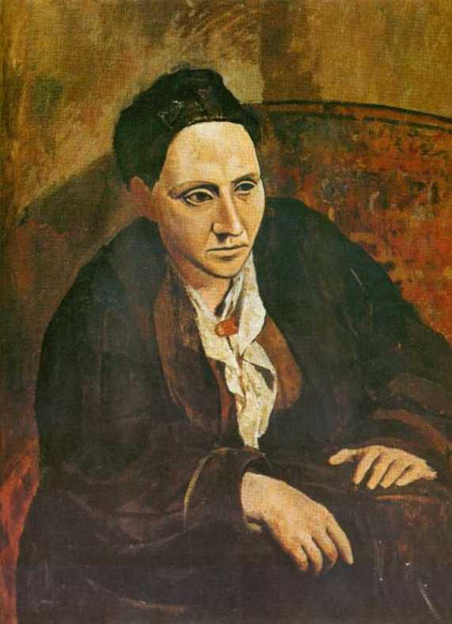
Round 15: Visual Arts
Question #2:
Identify the subject of this renowned Picasso.
3s
Twelve: Sample Competition
Copyright © 2010. All Rights Reserved.
North Carolina Association for Scholastic Activities

Slide 296
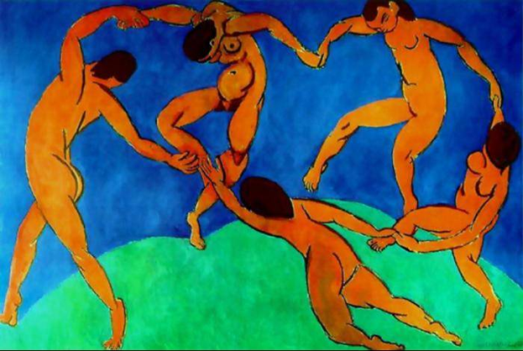
Round 15: Visual Arts
Question #3:
The Dance, found in St. Petersburg’s Hermitage Museum, was created by what artist?
3s
Twelve: Sample Competition
Copyright © 2010. All Rights Reserved.
North Carolina Association for Scholastic Activities

Slide 297
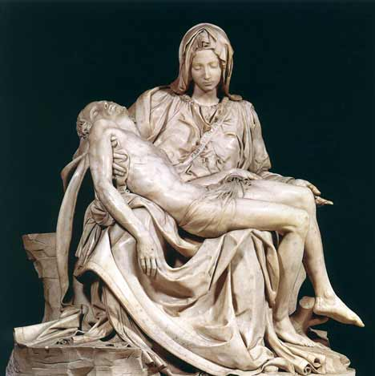
Round 15: Visual Arts
Question #4:
Michaelangelo’s La Pieta is housed in what European church?
3s
Twelve: Sample Competition
Copyright © 2010. All Rights Reserved.
North Carolina Association for Scholastic Activities

Slide 298
Round 15: Visual Arts
Question #5:
Mural paintings created on plaster walls or ceilings are known as what?
3s
Twelve: Sample Competition
Copyright © 2010. All Rights Reserved.
North Carolina Association for Scholastic Activities

Slide 299
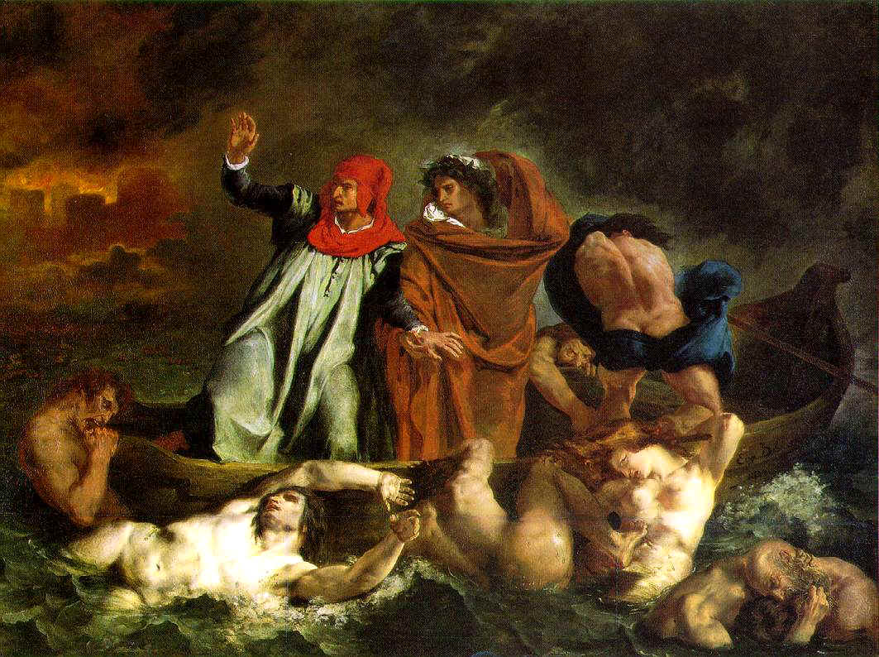
Round 15: Visual Arts
Question #6:
Dante and Virgil was created by what 19th century artist?
3s
Twelve: Sample Competition
Copyright © 2010. All Rights Reserved.
North Carolina Association for Scholastic Activities

Slide 300
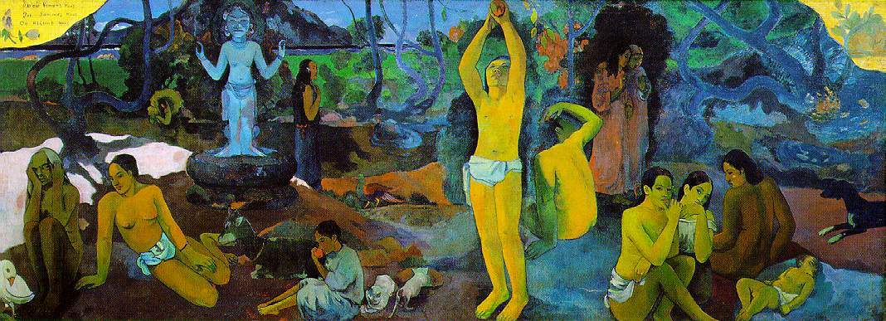
Round 15: Visual Arts
Question #7:
Name the artist and the piece.
3s
Twelve: Sample Competition
Copyright © 2010. All Rights Reserved.
North Carolina Association for Scholastic Activities

Slide 301
Round 15: Visual Arts
Question #8:
What painting by Johannes Vermeer was later the inspiration for a novel and a film with the same title?
3s
Twelve: Sample Competition
Copyright © 2010. All Rights Reserved.
North Carolina Association for Scholastic Activities

Slide 302
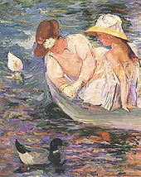
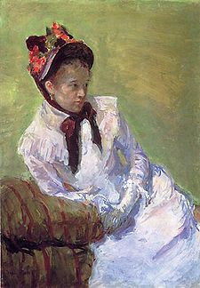
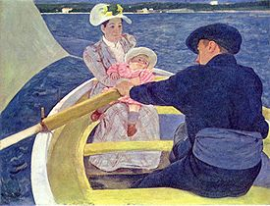
Round 15: Visual Arts
Question #9:
Identify the artist.
3s
Twelve: Sample Competition
Copyright © 2010. All Rights Reserved.
North Carolina Association for Scholastic Activities

Slide 303
Round 15: Visual Arts
Question #10:
What sculpture of a sitting man, created by Auguste Rodin, is often used to represent philosophy?
3s
Twelve: Sample Competition
Copyright © 2010. All Rights Reserved.
North Carolina Association for Scholastic Activities

Slide 304
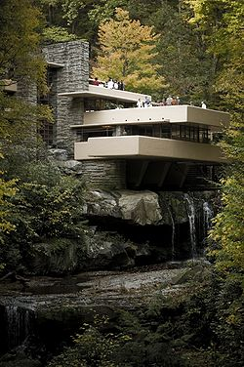
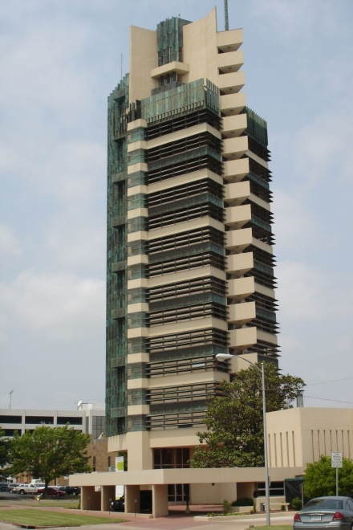
Round 15: Visual Arts
Question #11:
What architect designed Fallingwater and the Price Tower?
3s
Twelve: Sample Competition
Copyright © 2010. All Rights Reserved.
North Carolina Association for Scholastic Activities

Slide 305
Round 15: Visual Arts
Question #12:
What artistic technique, characterized by contrast between light and dark, has a named derived from the Italian words for “light” and “dark”?
3s
Twelve: Sample Competition
Copyright © 2010. All Rights Reserved.
North Carolina Association for Scholastic Activities

Slide 306
Round 15: Visual Arts
Students have 3 minutes to complete their answer sheets.
Twelve: Sample Competition
Copyright © 2010. All Rights Reserved.
North Carolina Association for Scholastic Activities

Slide 307
Round 15: Visual Arts
Students have 3 minutes to complete their answer sheets.
2 Minutes Remaining
Twelve: Sample Competition
Copyright © 2010. All Rights Reserved.
North Carolina Association for Scholastic Activities

Slide 308
Round 15: Visual Arts
Students have 3 minutes to complete their answer sheets.
1 Minute Remaining
Twelve: Sample Competition
Copyright © 2010. All Rights Reserved.
North Carolina Association for Scholastic Activities

Slide 309
Round 15: Visual Arts
Students have 3 minutes to complete their answer sheets.
10 Seconds Remaining
Twelve: Sample Competition
Copyright © 2010. All Rights Reserved.
North Carolina Association for Scholastic Activities

Slide 310
Round 15: Visual Arts
TIME
Pencils Down.
Answer sheets will now be collected.
Twelve: Sample Competition
Copyright © 2010. All Rights Reserved.
North Carolina Association for Scholastic Activities

Slide 311
Round 15: Visual Arts
Answers for Visual Arts questions follow on next slide.
Advance once all answer sheets have been collected.
Students may return to their team.
Twelve: Sample Competition
Copyright © 2010. All Rights Reserved.
North Carolina Association for Scholastic Activities

Slide 312
Round 15: Visual Arts
Answers
Francisco Goya
Gertrude Stein
Henry Matisse
St. Peter’s Basilica
Fresco
Delacroix
Paul Gauguin, Where Do We Come From? What Are We? Where Are We Going?
Girl With A Pearl Earring
Mary Cassatt
The Thinker
Frank Lloyd Wright
chiaroscuro
Twelve: Sample Competition
Copyright © 2010. All Rights Reserved.
North Carolina Association for Scholastic Activities

Slide 313
Round 16: Performing Arts
Students are seated and ready to begin.
Twelve: Sample Competition
Copyright © 2010. All Rights Reserved.
North Carolina Association for Scholastic Activities

Slide 314
Round 16: Performing Arts
Question #1:
What comedian is best known for his HBO routine: “The seven things you can never say on television”?
3s
Twelve: Sample Competition
Copyright © 2010. All Rights Reserved.
North Carolina Association for Scholastic Activities

Slide 315
Round 16: Performing Arts
Question #2:
The song “Memories” is from what Broadway musical that opened in 1981?
3s
Twelve: Sample Competition
Copyright © 2010. All Rights Reserved.
North Carolina Association for Scholastic Activities

Slide 316
Round 16: Performing Arts
Question #3:
What rock opera, telling the story of young artists and musicians struggling in New York’s Lower East Side, won the Pulitzer and Tony Awards in the 1990s and led to a resurgence in the popularity of musicals with younger audiences?
3s
Twelve: Sample Competition
Copyright © 2010. All Rights Reserved.
North Carolina Association for Scholastic Activities

Slide 317
Round 16: Performing Arts
Question #4:
Variations of this style of dance include the Hesitation, the Viennese, and the Country Western.
3s
Twelve: Sample Competition
Copyright © 2010. All Rights Reserved.
North Carolina Association for Scholastic Activities

Slide 318
Round 16: Performing Arts
Question #5:
What female vocalist collaborated with Cole Porter and Duke Ellington on The Great American Songbook?
3s
Twelve: Sample Competition
Copyright © 2010. All Rights Reserved.
North Carolina Association for Scholastic Activities

Slide 319
Round 16: Performing Arts
Question #6:
What gospel and country artist’s early hits included “Cry, Cry, Cry” and “I Walk the Line”?
3s
Twelve: Sample Competition
Copyright © 2010. All Rights Reserved.
North Carolina Association for Scholastic Activities

Slide 320
Round 16: Performing Arts
Question #7:
What bandleader, whose unusual accent enhanced his popularity, led a music show for over thirty years, featuring different styles of music, known collectively as “champagne music”?
3s
Twelve: Sample Competition
Copyright © 2010. All Rights Reserved.
North Carolina Association for Scholastic Activities

Slide 321
Round 16: Performing Arts
Question #8:
Who is the only musician inducted into the Rock and Roll Hall of Fame three times – as a member of The Yardbirds, Cream, and as a solo artist?
3s
Twelve: Sample Competition
Copyright © 2010. All Rights Reserved.
North Carolina Association for Scholastic Activities

Slide 322
Round 16: Performing Arts
Question #9:
Which of Andrew Lloyd Webber’s former wives appeared in several musicals containing his compositions?
3s
Twelve: Sample Competition
Copyright © 2010. All Rights Reserved.
North Carolina Association for Scholastic Activities

Slide 323
Round 16: Performing Arts
Question #10:
Who played the role of Elphaba in the original Broadway production of Wicked?
3s
Twelve: Sample Competition
Copyright © 2010. All Rights Reserved.
North Carolina Association for Scholastic Activities

Slide 324
Round 16: Performing Arts
Question #11:
What musical term comes from the Italian word meaning “tied” or “connected”?
3s
Twelve: Sample Competition
Copyright © 2010. All Rights Reserved.
North Carolina Association for Scholastic Activities

Slide 325
Round 16: Performing Arts
Question #12:
In what instrumental family is a saxophone classified?
3s
Twelve: Sample Competition
Copyright © 2010. All Rights Reserved.
North Carolina Association for Scholastic Activities

Slide 326
Round 16: Performing Arts
Students have 3 minutes to complete their answer sheets.
Twelve: Sample Competition
Copyright © 2010. All Rights Reserved.
North Carolina Association for Scholastic Activities

Slide 327
Round 16: Performing Arts
Students have 3 minutes to complete their answer sheets.
2 Minutes Remaining
Twelve: Sample Competition
Copyright © 2010. All Rights Reserved.
North Carolina Association for Scholastic Activities

Slide 328
Round 16: Performing Arts
Students have 3 minutes to complete their answer sheets.
1 Minute Remaining
Twelve: Sample Competition
Copyright © 2010. All Rights Reserved.
North Carolina Association for Scholastic Activities

Slide 329
Round 16: Performing Arts
Students have 3 minutes to complete their answer sheets.
10 Seconds Remaining
Twelve: Sample Competition
Copyright © 2010. All Rights Reserved.
North Carolina Association for Scholastic Activities

Slide 330
Round 16: Performing Arts
TIME
Pencils Down.
Answer sheets will now be collected.
Twelve: Sample Competition
Copyright © 2010. All Rights Reserved.
North Carolina Association for Scholastic Activities

Slide 331
Round 16: Performing Arts
Answers for Performing Arts questions follow on next slide.
Advance once all answer sheets have been collected.
Students may return to their team.
Twelve: Sample Competition
Copyright © 2010. All Rights Reserved.
North Carolina Association for Scholastic Activities

Slide 332
Round 16: Performing Arts
Answers
George Carlin
Cats
Rent
Waltz
Ella Fitzgerald
Johnny Cash
Lawrence Welk
Eric Clapton
Sarah Brightman
Idina Menzel
Legato
Woodwind
Twelve: Sample Competition
Copyright © 2010. All Rights Reserved.
North Carolina Association for Scholastic Activities

Slide 333
Round 17: Geography
Students are seated and ready to begin.
Twelve: Sample Competition
Copyright © 2010. All Rights Reserved.
North Carolina Association for Scholastic Activities

Slide 334
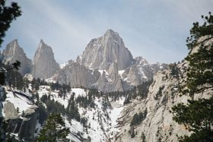
Round 17: Geography
Question #1:
What California mountain is the highest peak in the continental United States?
3s
Twelve: Sample Competition
Copyright © 2010. All Rights Reserved.
North Carolina Association for Scholastic Activities

Slide 335
Round 17: Geography
Question #2:
What two South American countries are landlocked?
3s
Twelve: Sample Competition
Copyright © 2010. All Rights Reserved.
North Carolina Association for Scholastic Activities

Slide 336
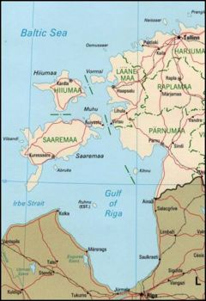
Round 17: Geography
Question #3:
Which two European countries share the Gulf of Riga, a bay on the Baltic Sea?
3s
Twelve: Sample Competition
Copyright © 2010. All Rights Reserved.
North Carolina Association for Scholastic Activities

Slide 337
Round 17: Geography
Question #4:
The Naff River partially divides what two Asian countries?
3s
Twelve: Sample Competition
Copyright © 2010. All Rights Reserved.
North Carolina Association for Scholastic Activities

Slide 338
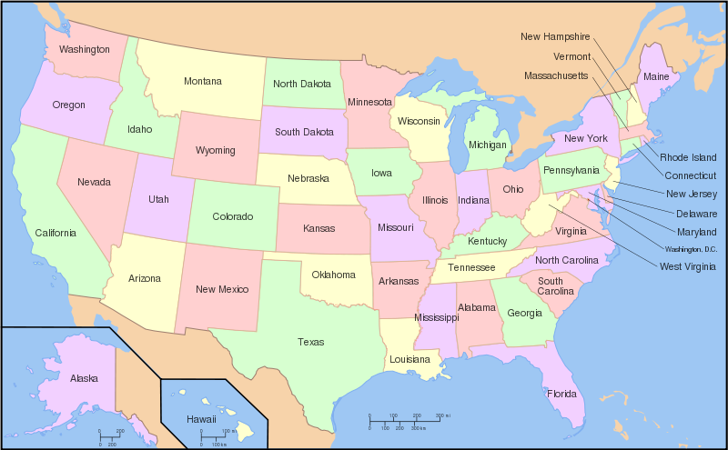
Round 17: Geography
Question #5:
Name the only 2 states that border 8 states.
Hint: These 2 states border each other.
3s
Twelve: Sample Competition
Copyright © 2010. All Rights Reserved.
North Carolina Association for Scholastic Activities

Slide 339
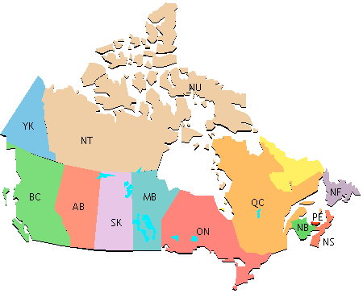
Round 17: Geography
Question #6:
Whitehorse is the capital of which Canadian territory?
3s
Twelve: Sample Competition
Copyright © 2010. All Rights Reserved.
North Carolina Association for Scholastic Activities

Slide 340
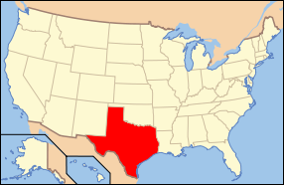
Round 17: Geography
Question #7:
Name the 3 rivers that form portions of Texas’s borders.
3s
Twelve: Sample Competition
Copyright © 2010. All Rights Reserved.
North Carolina Association for Scholastic Activities

Slide 341
Round 17: Geography
Question #8:
What mountain range extends across the borders of France and Spain?
3s
Twelve: Sample Competition
Copyright © 2010. All Rights Reserved.
North Carolina Association for Scholastic Activities

Slide 342
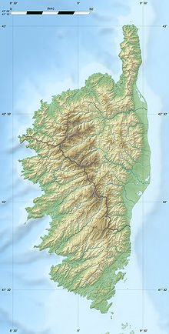
Round 17: Geography
Question #9:
What French island is separated from the mainland by the Ligurian Sea?
3s
Twelve: Sample Competition
Copyright © 2010. All Rights Reserved.
North Carolina Association for Scholastic Activities

Slide 343
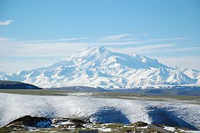
Round 17: Geography
Question #10:
Mt. Elbrus, the highest point in Europe, is found in what mountain range?
3s
Twelve: Sample Competition
Copyright © 2010. All Rights Reserved.
North Carolina Association for Scholastic Activities

Slide 344
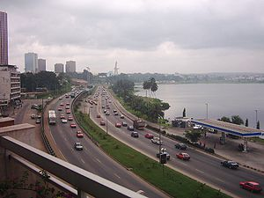
Round 17: Geography
Question #11:
Abidjan is the main port, economic center, former capital, and current largest city of what African Nation?
3s
Twelve: Sample Competition
Copyright © 2010. All Rights Reserved.
North Carolina Association for Scholastic Activities

Slide 345
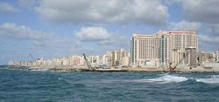
Round 17: Geography
Question #12:
What is Egypt’s second largest city and primary port?
3s
Twelve: Sample Competition
Copyright © 2010. All Rights Reserved.
North Carolina Association for Scholastic Activities

Slide 346
Round 17: Geography
Students have 3 minutes to complete their answer sheets.
Twelve: Sample Competition
Copyright © 2010. All Rights Reserved.
North Carolina Association for Scholastic Activities

Slide 347
Round 17: Geography
Students have 3 minutes to complete their answer sheets.
2 Minutes Remaining
Twelve: Sample Competition
Copyright © 2010. All Rights Reserved.
North Carolina Association for Scholastic Activities

Slide 348
Round 17: Geography
Students have 3 minutes to complete their answer sheets.
1 Minute Remaining
Twelve: Sample Competition
Copyright © 2010. All Rights Reserved.
North Carolina Association for Scholastic Activities

Slide 349
Round 17: Geography
Students have 3 minutes to complete their answer sheets.
10 Seconds Remaining
Twelve: Sample Competition
Copyright © 2010. All Rights Reserved.
North Carolina Association for Scholastic Activities

Slide 350
Round 17: Geography
TIME
Pencils Down.
Answer sheets will now be collected.
Twelve: Sample Competition
Copyright © 2010. All Rights Reserved.
North Carolina Association for Scholastic Activities

Slide 351
Round 17: Geography
Answers for Geography questions follow on next slide.
Advance once all answer sheets have been collected.
Students may return to their team.
Twelve: Sample Competition
Copyright © 2010. All Rights Reserved.
North Carolina Association for Scholastic Activities

Slide 352
Round 17: Geography
Answers
Mt. Whitney
Bolivia, Paraguay
Latvia, Estonia
Burma (Myanmar), Bangladesh
Tennessee, Missouri
Yukon
Rio Grande, Sabine, Red
Pyrenees
Corsica
Caucasus
Cote d’Ivoire
Alexandria
Twelve: Sample Competition
Copyright © 2010. All Rights Reserved.
North Carolina Association for Scholastic Activities

Slide 353
Round 18: Current Events
Students are seated and ready to begin.
Twelve: Sample Competition
Copyright © 2010. All Rights Reserved.
North Carolina Association for Scholastic Activities

Slide 354
Round 18: Current Events
Question #1:
What Supreme Court Justice recently retired, leading to the confirmation of Elena Hagan?
3s
Twelve: Sample Competition
Copyright © 2010. All Rights Reserved.
North Carolina Association for Scholastic Activities

Slide 355
Round 18: Current Events
Question #2:
The commander of which North Carolina law enforcement agency recently resigned his post in response to an ethics scandal?
3s
Twelve: Sample Competition
Copyright © 2010. All Rights Reserved.
North Carolina Association for Scholastic Activities

Slide 356
Round 18: Current Events
Question #3:
What international governing body announced its plans to investigate a recent incident involving Israeli Defense Force troops and Turkish activists on a flotilla entering Gaza?
3s
Twelve: Sample Competition
Copyright © 2010. All Rights Reserved.
North Carolina Association for Scholastic Activities

Slide 357
Round 18: Current Events
Question #4:
On July 28, 2010, Catalonia’s regional parliament banned which traditional Spanish activity?
3s
Twelve: Sample Competition
Copyright © 2010. All Rights Reserved.
North Carolina Association for Scholastic Activities

Slide 358
Round 18: Current Events
Question #5:
Which country’s president offered asylum to an Iranian woman who was convicted of adultery and sentenced to death by stoning?
3s
Twelve: Sample Competition
Copyright © 2010. All Rights Reserved.
North Carolina Association for Scholastic Activities

Slide 359
Round 18: Current Events
Question #6:
What garment was controversially banned in France?
3s
Twelve: Sample Competition
Copyright © 2010. All Rights Reserved.
North Carolina Association for Scholastic Activities

Slide 360
Round 18: Current Events
Question #7:
Classified documents released by the watchdog website Wikileaks indicated that the United States was aware of what country’s assistance of Al-Qaeda in Afghanistan?
3s
Twelve: Sample Competition
Copyright © 2010. All Rights Reserved.
North Carolina Association for Scholastic Activities

Slide 361
Round 18: Current Events
Question #8:
Which nation was the first to ban the web capabilities of Blackberry smartphones?
3s
Twelve: Sample Competition
Copyright © 2010. All Rights Reserved.
North Carolina Association for Scholastic Activities

Slide 362
Round 18: Current Events
Question #9:
Which nation recently declared a state of emergency in response to raging wildfires that devastated hundreds of towns?
3s
Twelve: Sample Competition
Copyright © 2010. All Rights Reserved.
North Carolina Association for Scholastic Activities

Slide 363
Round 18: Current Events
Question #10:
Which nation became the first NATO member to withdraw from Afghanistan?
3s
Twelve: Sample Competition
Copyright © 2010. All Rights Reserved.
North Carolina Association for Scholastic Activities

Slide 364
Round 18: Current Events
Question #11:
Scientists John Scannella and Jack Horner concluded that the triceratops is the juvenile version of which dinosaur species?
3s
Twelve: Sample Competition
Copyright © 2010. All Rights Reserved.
North Carolina Association for Scholastic Activities

Slide 365
Round 18: Current Events
Question #12:
Which news outlet is the most recent addition to the front row of the White House Briefing Room?
3s
Twelve: Sample Competition
Copyright © 2010. All Rights Reserved.
North Carolina Association for Scholastic Activities

Slide 366
Round 18: Current Events
Students have 3 minutes to complete their answer sheets.
Twelve: Sample Competition
Copyright © 2010. All Rights Reserved.
North Carolina Association for Scholastic Activities

Slide 367
Round 18: Current Events
Students have 3 minutes to complete their answer sheets.
2 Minutes Remaining
Twelve: Sample Competition
Copyright © 2010. All Rights Reserved.
North Carolina Association for Scholastic Activities

Slide 368
Round 18: Current Events
Students have 3 minutes to complete their answer sheets.
1 Minute Remaining
Twelve: Sample Competition
Copyright © 2010. All Rights Reserved.
North Carolina Association for Scholastic Activities

Slide 369
Round 18: Current Events
Students have 3 minutes to complete their answer sheets.
10 Seconds Remaining
Twelve: Sample Competition
Copyright © 2010. All Rights Reserved.
North Carolina Association for Scholastic Activities

Slide 370
Round 18: Current Events
TIME
Pencils Down.
Answer sheets will now be collected.
Twelve: Sample Competition
Copyright © 2010. All Rights Reserved.
North Carolina Association for Scholastic Activities

Slide 371
Round 18: Current Events
Answers for Current Events questions follow on next slide.
Advance once all answer sheets have been collected.
Students may return to their team.
Twelve: Sample Competition
Copyright © 2010. All Rights Reserved.
North Carolina Association for Scholastic Activities

Slide 372
Round 18: Current Events
Answers
John Paul Stevens
NC State Highway Patrol
United Nations
Bullfighting
Brazil
Burqa
Pakistan
United Arab Emirates
Russia
Netherlands
Torosaurus
Fox News
Twelve: Sample Competition
Copyright © 2010. All Rights Reserved.
North Carolina Association for Scholastic Activities

